Slide 1
Thesis Defense
Examining the local-scale relationship between
human mobility and COVID-19:
A case study of San Diego, CA
Huong Pham
Big Data Analytics
San Diego State University
December 13, 2022
Thesis Committee:
Dr. Atsushi Nara (Chair), Department of Geography
Dr. Ming-Hsiang Tsou, Department of Geography
Dr. Eyal Oren, School of Public Health

Slide 2

agenda
Introduction
Literature Review
Data
Methods
Results
Discussion
Conclusion
Acknowledgement

Slide 3
INTRODUCTION
COVID-19 Disease
Caused by SARS-CoV-2, one of the seven types of coronaviruses
Airborne, contagious, deadly
Six million deaths worldwide, business and economies affected
How to control the COVID-19 spread?
Vaccination
Human behavior (mask-wearing, hygiene, physical distancing)
Reduce human movement to reduce close contact
Notes:
https://www.hopkinsmedicine.org/health/conditions-and-diseases/coronavirus/a-new-strain-of-coronavirus-what-you-should-know

Slide 4

STUDY AREA
San Diego
41 SRAs
Location: border with Mexico
City vs. Rural areas
Tourism + International Trade
Diverse racial and ethnic composition
High concentration of immigrants and first-generation Americans
COVID-19 in San Diego

Slide 5
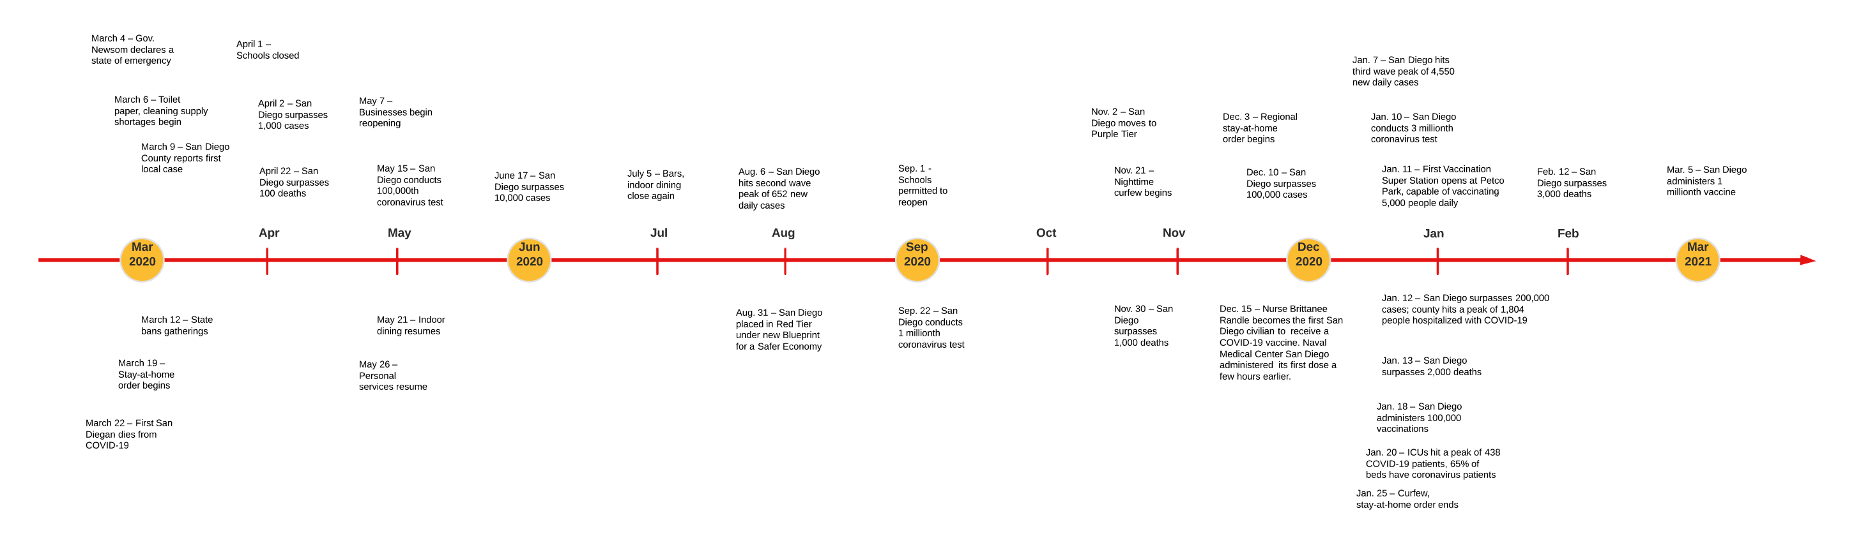
A Timeline of Events Relating to COVID-19 in San Diego County (Lewis, 2021)

Slide 6

Literature Review

Slide 7
Study Number | Study Name
1 | Global and local mobility as a barometer for COVID-19 dynamics. (Linka et al., 2020)
2 | Association between mobility patterns and COVID-19 transmission in the USA: a mathematical modelling study (Badr et al., 2020)
3 | Outbreak dynamics of COVID-19 in Europe and the effect of travel restrictions (Linka et al., 2020)
4 | Examining the Change of Human Mobility Adherent to Social Restriction Policies and Its Effect on COVID-19 Cases in Australia (Wang et al., 2020)
5 | State heterogeneity in the associations of human mobility with COVID-19 epidemics in the European Union (Yuan et al., 2020)
6 | Using a partial differential equation with Google Mobility data to predict COVID-19 in Arizona (Wang et al., 2020)
7 | Spread of COVID-19 in China: analysis from a city-based epidemic and mobility model (Wei et al., 2020)
8 | Mobile device location data reveal human mobility response to state-level stay-at-home orders during the COVID-19 pandemic in the USA (Xiong et al., 2020)
9 | Airborne particulate matter, population mobility and COVID-19: a multi-city study in China (Wang et al., 2020)
10 | The effect of human mobility and control measures on the COVID-19 epidemic in China (Kraemer et al., 2020)
11 | Mobility network models of COVID-19 explain inequities and inform reopening (Chang et al., 2020)
12 | Measuring mobility to monitor travel and physical distancing interventions: a common framework for mobile phone data analysis (Kishore, et al., 2020)
13 | Mining Google and Apple mobility data: temporal anatomy for COVID-19 social distancing (Cot et al., 2021)
14 | County-Level Social Distancing and Policy Impact in the United States: A Dynamical Systems Model (McKee et al., 2020)
15 | Estimation of COVID-19 dynamics in the different states of the United States using Time-Series Clustering (Rojasa et al., 2020)
16 | Epidemiology of Coronavirus COVID-19: Forecastingthe Future Incidence in Different Countries (Tubinger et al., 2020)
17 | Human mobility and poverty as key drivers of COVID-19 transmission and control (Yechezkel et al., 2021)
18 | Spatial-Temporal Relationship Between Population Mobility and COVID-19 Outbreaks in South Carolina: Time Series Forecasting Analysis (Zeng et al., 2021)
19 | What human mobility data tell us about COVID-19 spread (Alessandretti, 2022)
20 | Change of human mobility during COVID-19: A United States case study (Elarde et al., 2021)
21 | Disparate patterns of movements and visits to points of interest located in urban hotspots across US metropolitan cities during COVID-19 (Li et al., 2020)
22 | Human mobility behavior in COVID-19: A systematic literature review and bibliometric analysis (Benita, 2021)
23 | Human mobility impacts on the surging incidence of COVID-19 in India (Praharaj, S., & Han, H., 2021)
24 | Monitoring the Spatial Spread of COVID-19 and Effectiveness of Control Measures Through Human Movement Data: Proposal for a Predictive Model Using Big Data Analytics (Li et al., 2020)
25 | Reduction in mobility and COVID-19 transmission Nouvellet et al. (Nouvellet et al., 2021)
”Human Mobility” “COVID-19”
Methods
Data, Time, Place

Slide 8
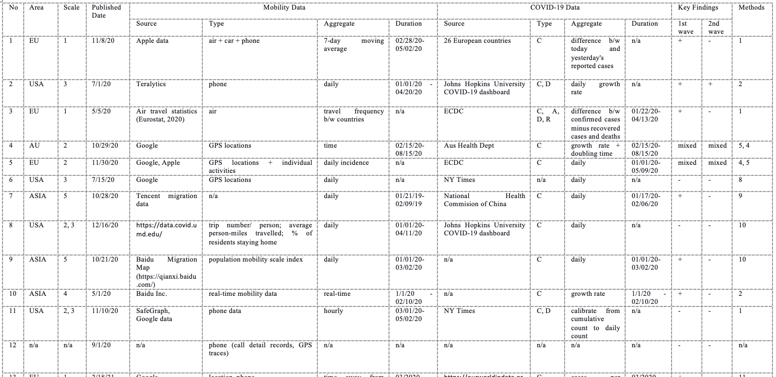
Literature Review

Slide 9
Literature Review
Research Findings
Human mobility // COVID-19 in initial stages
Mixed relationship after that
Time lag (7 days)
Geographic Scale
Country
State
County/ Province/ Region
=> Not much local/ neighborhood level

Slide 10

the gaP
Neighborhood level (data availability and data integration challenges)
Geographic spillover effect over time

Slide 11
Research objective
Examine the spatial and temporal dimensions of the relationship b/w human mobility and Covid-19 cases in San Diego Sub-Regional Areas
When did the human mobility influence the COVID-19 diffusion in San Diego?
Where did it happen?
What type of human mobility had more effect on San Diego COVID-19 transmission?
* Focus on increase-increase relationship

Slide 12

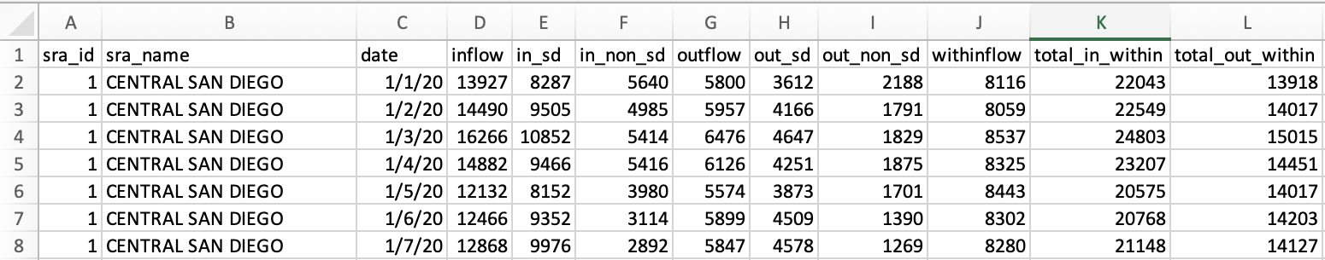
Data
1. Human Mobility, San Diego (provided by Dr. Nara)
https://docs.safegraph.com/docs/social-distancing-metrics
Mobile device count, generated by using a panel of GPS pings from anonymous mobile devices
Daily data at census block group (CBG) level, aggregated to SRA level
January 01, 2020 – April 16, 2021
Device count based on device number originated from a home CBG to a destination CBG, where each device stayed at least one minute at the destination CBG
Home refers to location where the device stayed 6pm – 7 am over a 6-week period
Notes:
Count the number of mobile devices.
Daily data at a census block group (CBG) level.
The data was generated using a panel of GPS pings from anonymous mobile devices.
The device count is based on the number of devices originated from a home CBG to a destination CBG, where each device stopped more than 1 minute at the destination CBG during the time period (1-day)
Home is defined as the common nighttime (6pm-7am) location for the device over a 6-week period.
SafeGraph data do not include any CBGs where the device count < 5.
Data Range: January 1, 2020 – current
Aggregated from CBG to SRA
https://www.youtube.com/watch?v=4amFPKUaNms
https://en.wikipedia.org/wiki/Differential_privacy
https://www.etechbag.com/how-to-ping-a-cell-phone/

Slide 13
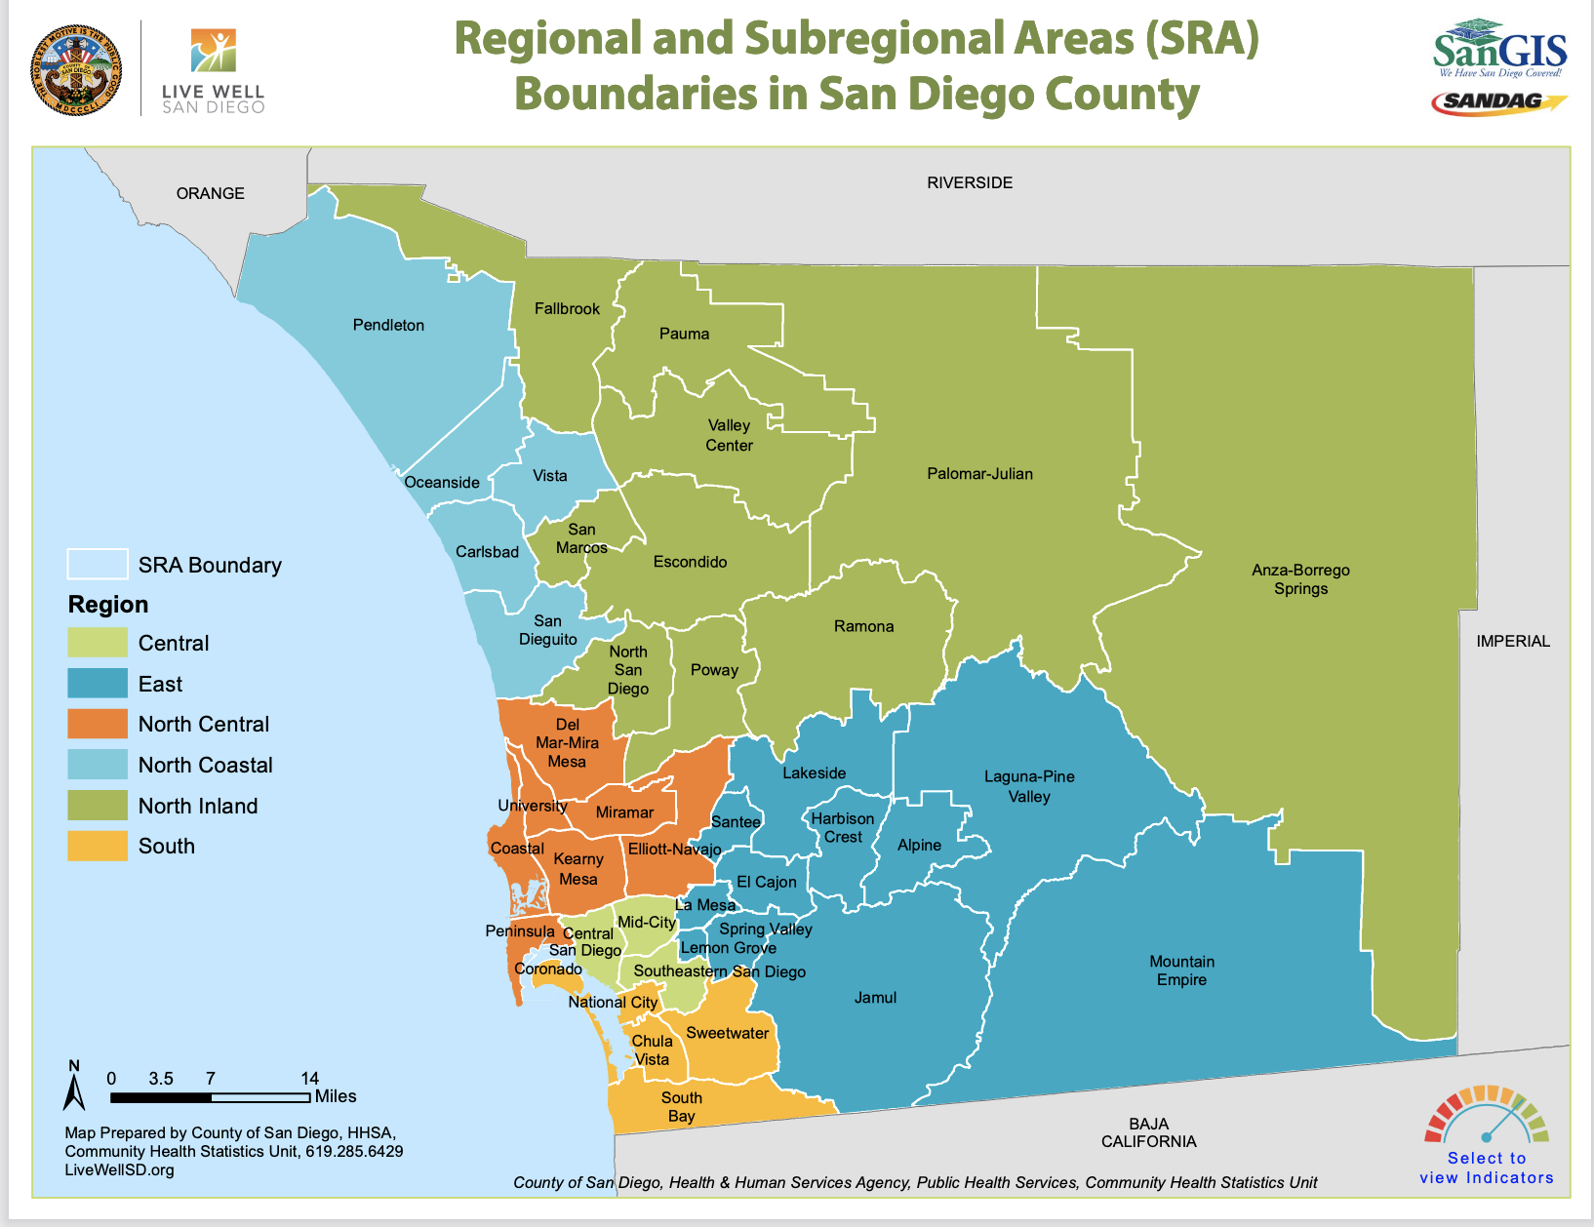

Slide 14
In from other counties or states
In from other SD SRAs

Slide 15
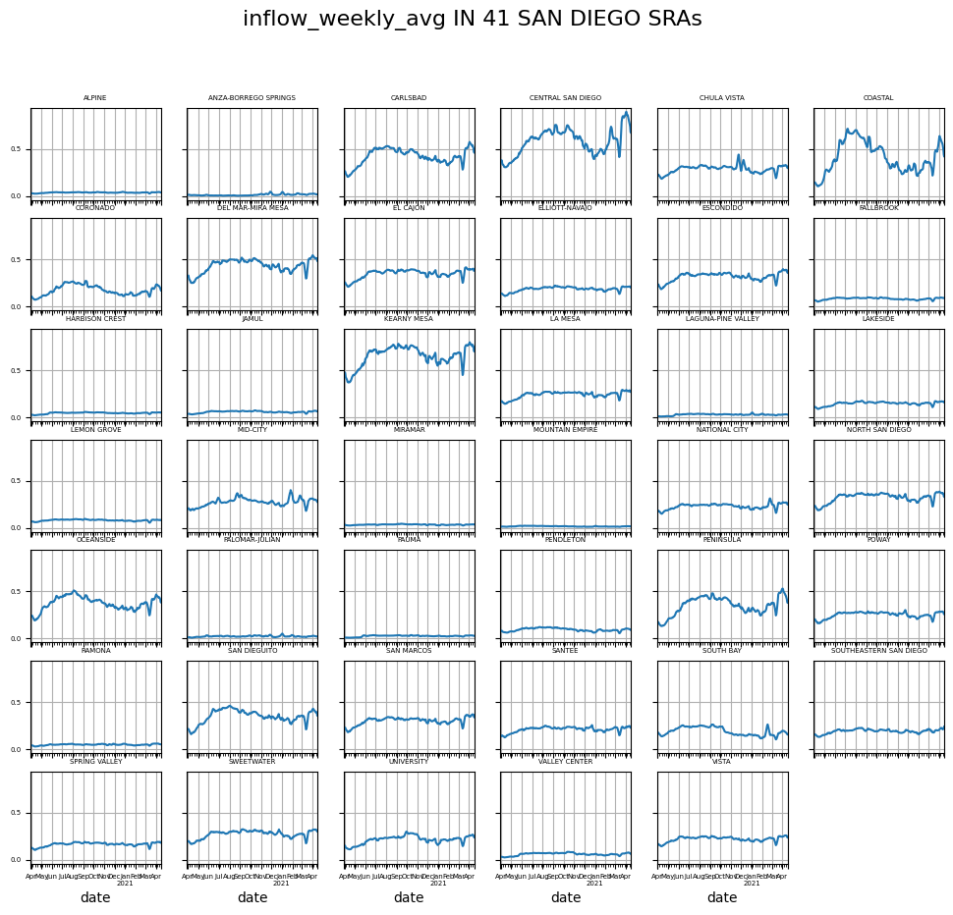
Figure 4.1. Weekly average human mobility inflow of 41 San Diego SRAs

Slide 16
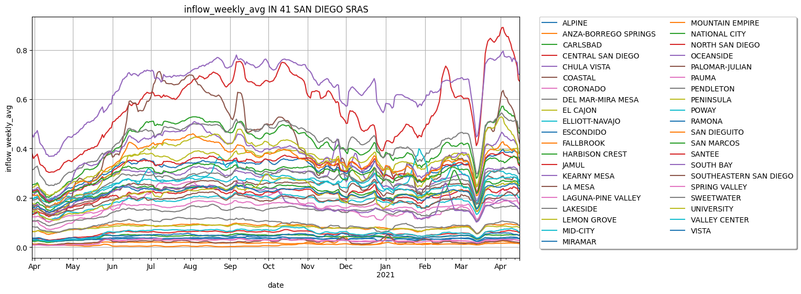
Normalized inflow

Slide 17
Out to other counties or states
Out to other SD SRAs

Slide 18
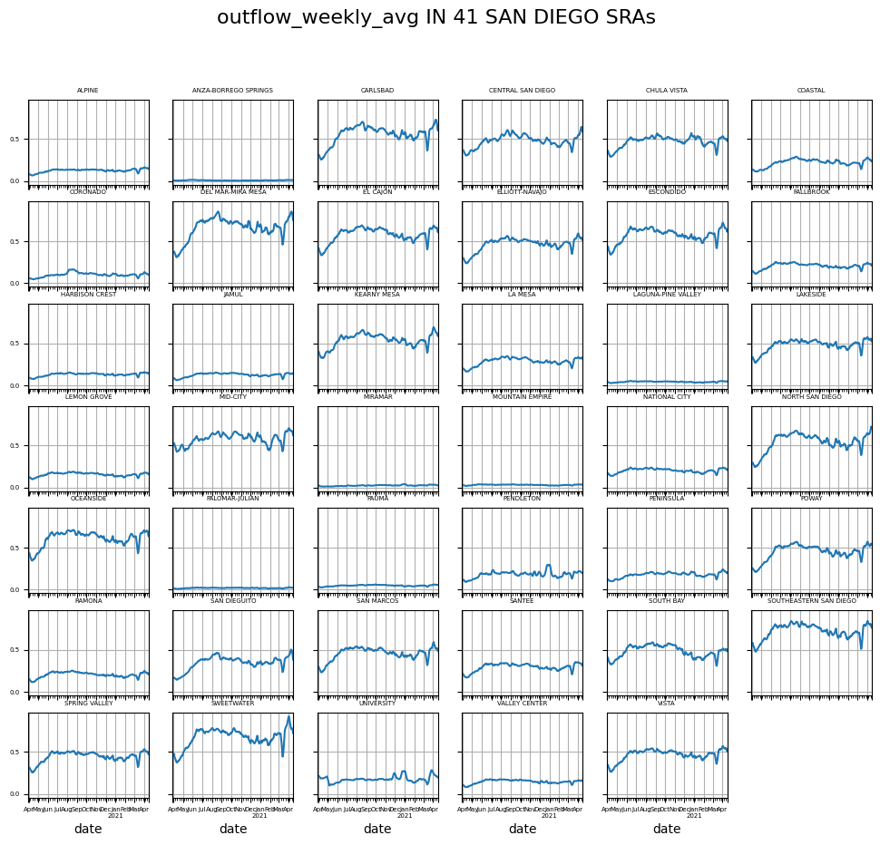
Figure 4.3. Weekly average human mobility outflow of 41 San Diego SRAs

Slide 19
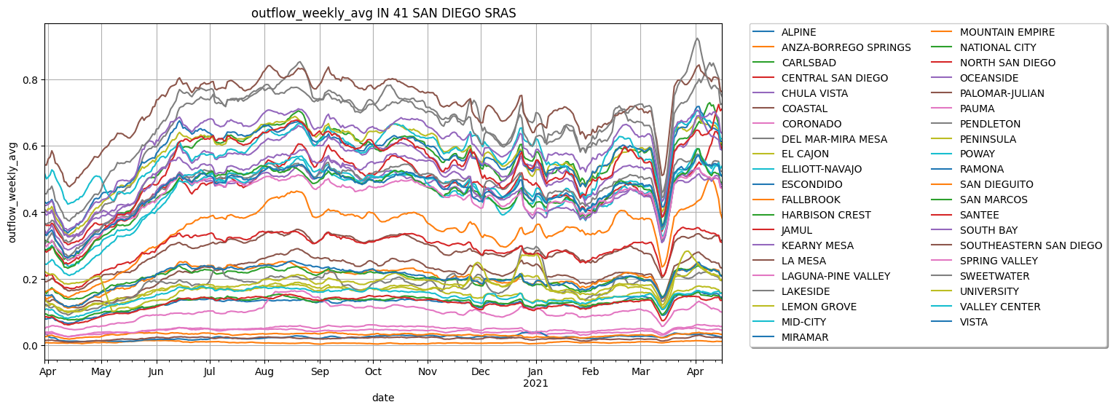
Normalized outflow

Slide 20
Within

Slide 21
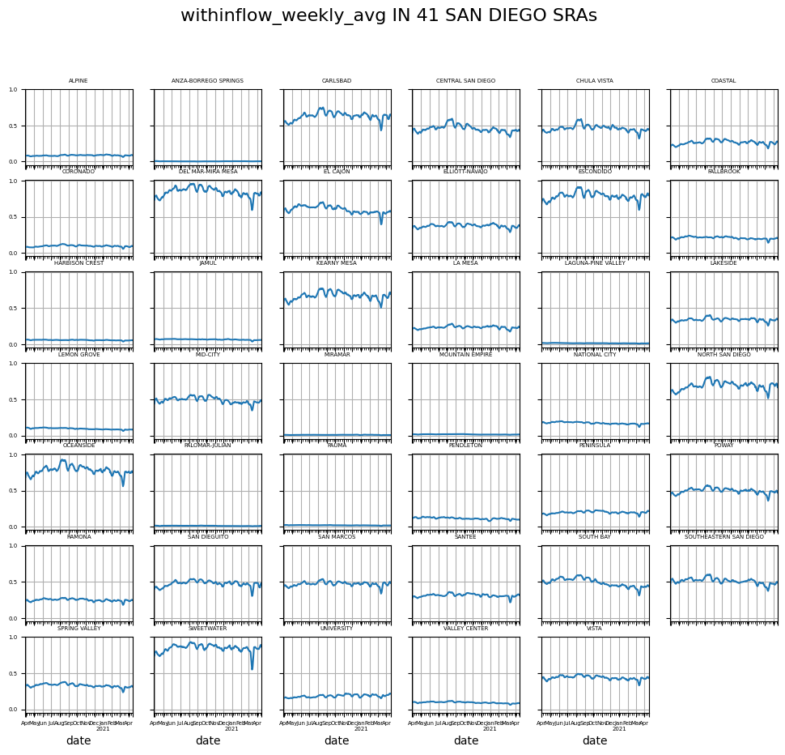
Figure 4.4. Weekly average human mobility withinflow of 41 San Diego SRAs

Slide 22
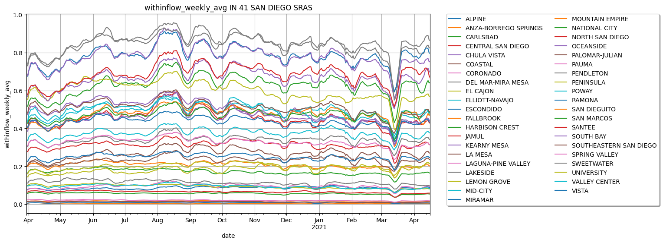
Normalized withinflow

Slide 23
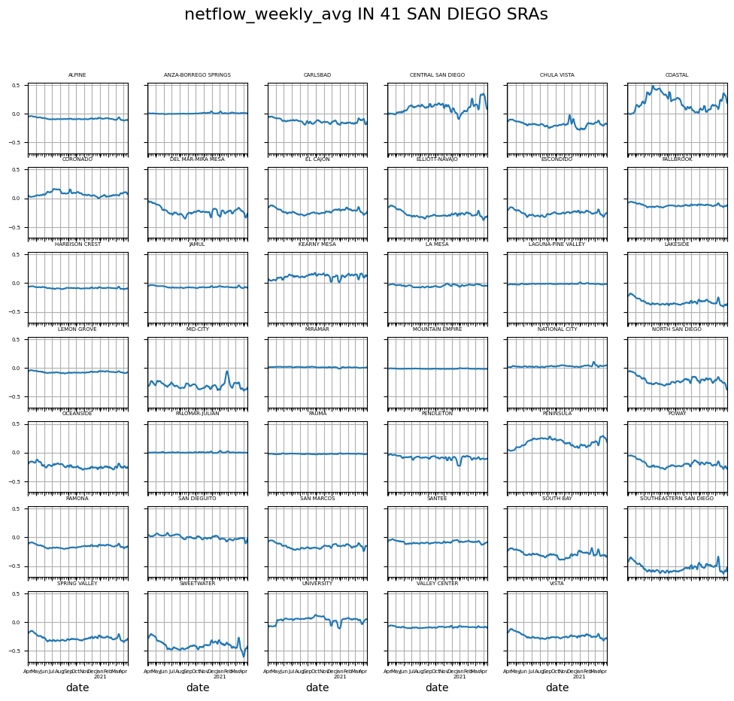
Figure 4.2. Weekly average human mobility netflow of 41 San Diego SRAs

Slide 24
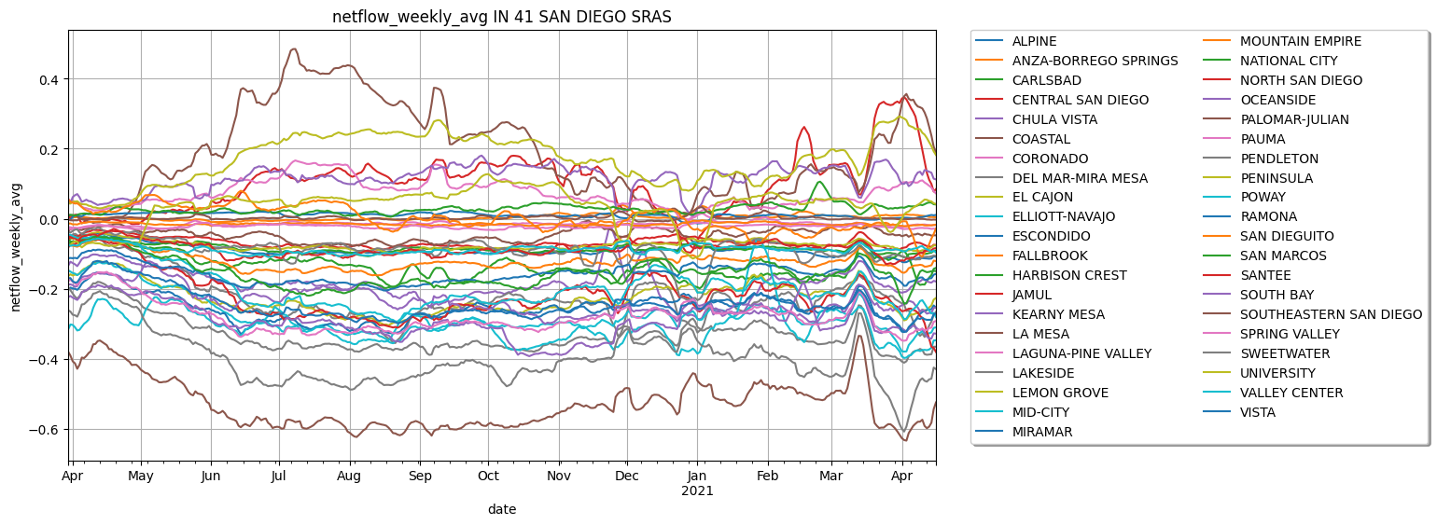
Normalized netflow

Slide 25
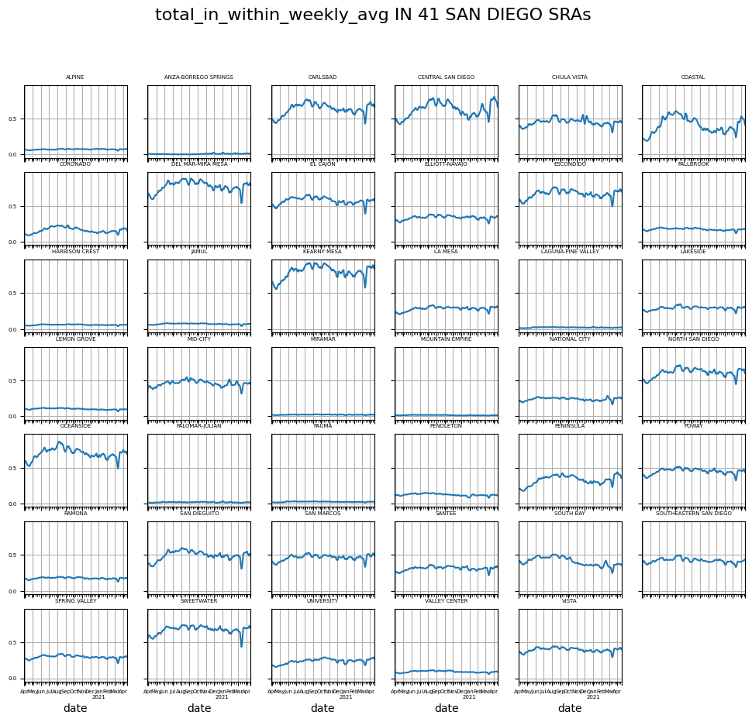
Figure 4.5. Weekly average human mobility total-in-within flow of 41 San Diego SRAs

Slide 26
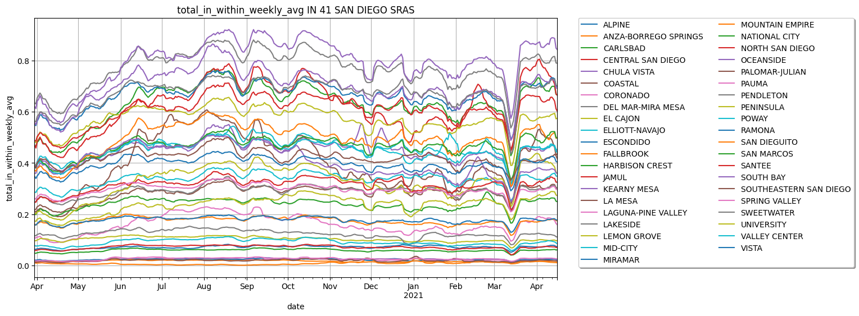
Normalized total_in_within flow

Slide 27
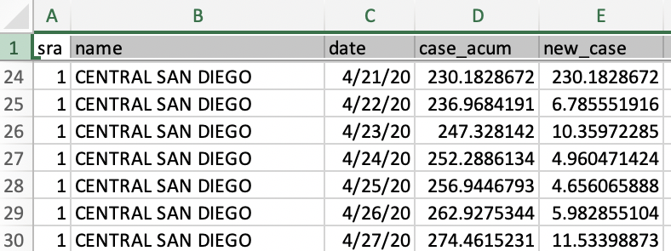
Data
2. Covid Cases in San Diego (provided by HDMA Center)
https://www.sandiegocounty.gov/hhsa/
Provided by the County of San Diego Health and Human Services Agency (HHSA)
March 30, 2020 – April 16, 2021
COVID-19 daily confirmed case number at SRA aggregated from the data at zip code level using dasymetric mapping
Notes:
https://www.usgs.gov/centers/western-geographic-science-center/science/dasymetric-mapping

Slide 28
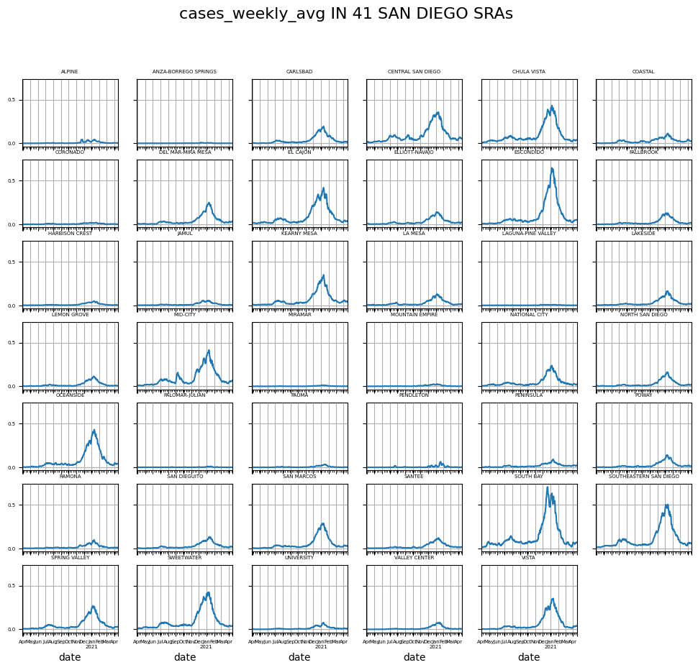
Figure 4.6. Weekly average COVID-19 confirmed new case number of each San Diego SRA

Slide 29
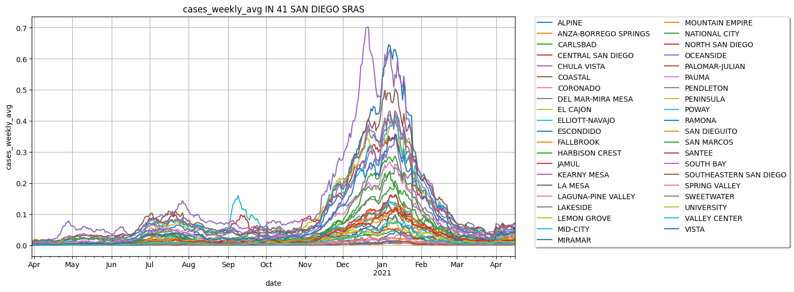
Figure 4.7. Weekly average COVID-19 confirmed new case numbers of all 41 San Diego SRAs

Slide 30



Methods
1. Python libraries
2. Dynamic Time Warping (DTW)
A flexible model to compare two or more time series
Smaller DTW distance indicates more similar trends; higher DTW distance indicates dissimilar trends
RD($x_{i}, y_{j}$) = d($x_{i}, y_{j}$) + min$\left\{\begin{aligned}RD\left(x_{i−1}, y_{j−1}\right) \\ RD\left(x_{i−1}, y_{j}\right) \\ RD\left(x_{i}, y_{j−1}\right)\end{aligned}\right.$
RD($x_{i}, y_{j}$) is the minimal cumulative distance from (0, 0) to (i, j) in matrix D.
DTW(X, Y) = min$\left\{RD(x_{n}, y_{m})\}\right.$
Notes:
https://medium.com/walmartglobaltech/time-series-similarity-using-dynamic-time-warping-explained-9d09119e48ec
https://towardsdatascience.com/an-illustrative-introduction-to-dynamic-time-warping-36aa98513b98

Slide 31
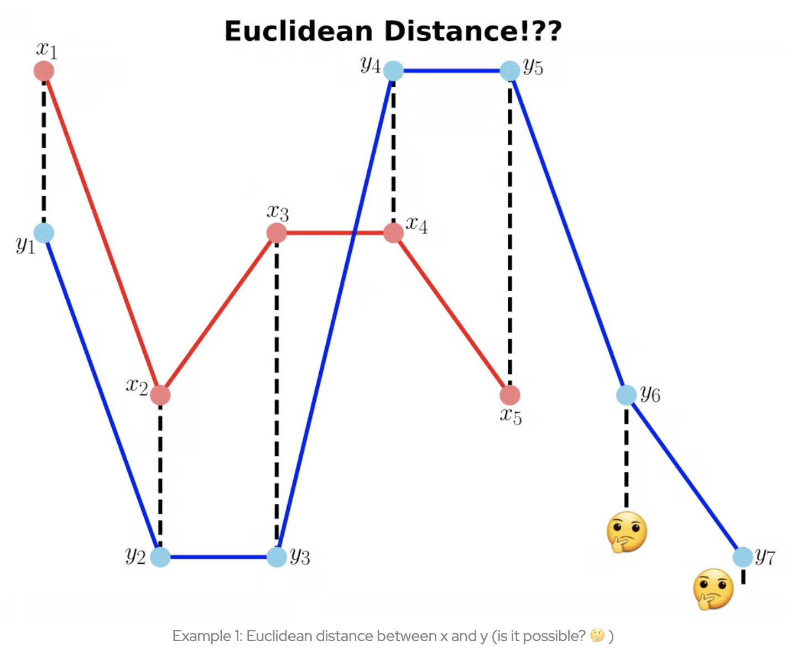
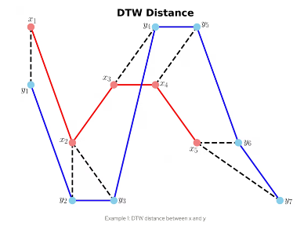
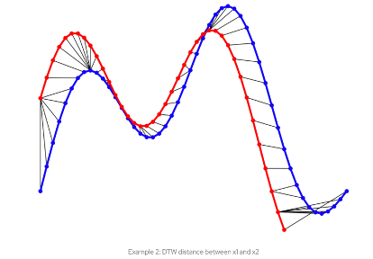
Methods
https://ealizadeh.com/blog/introduction-to-dynamic-time-warping

Slide 32
Methods
3. Slope calculation
Positive slopes of the mobility and COVID-19 means that both the time series tend to move in the same direction
Work with DTW to validate the relationship b/w mobility and COVID-19

Slide 33
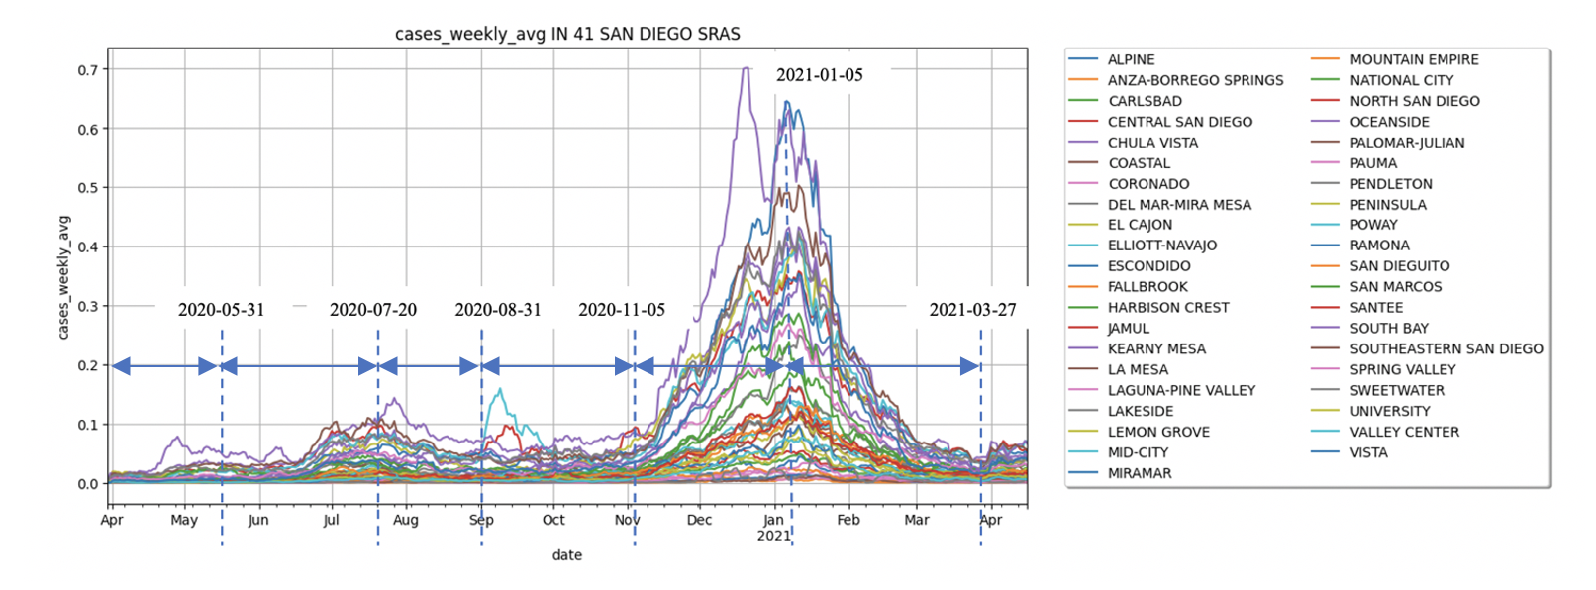
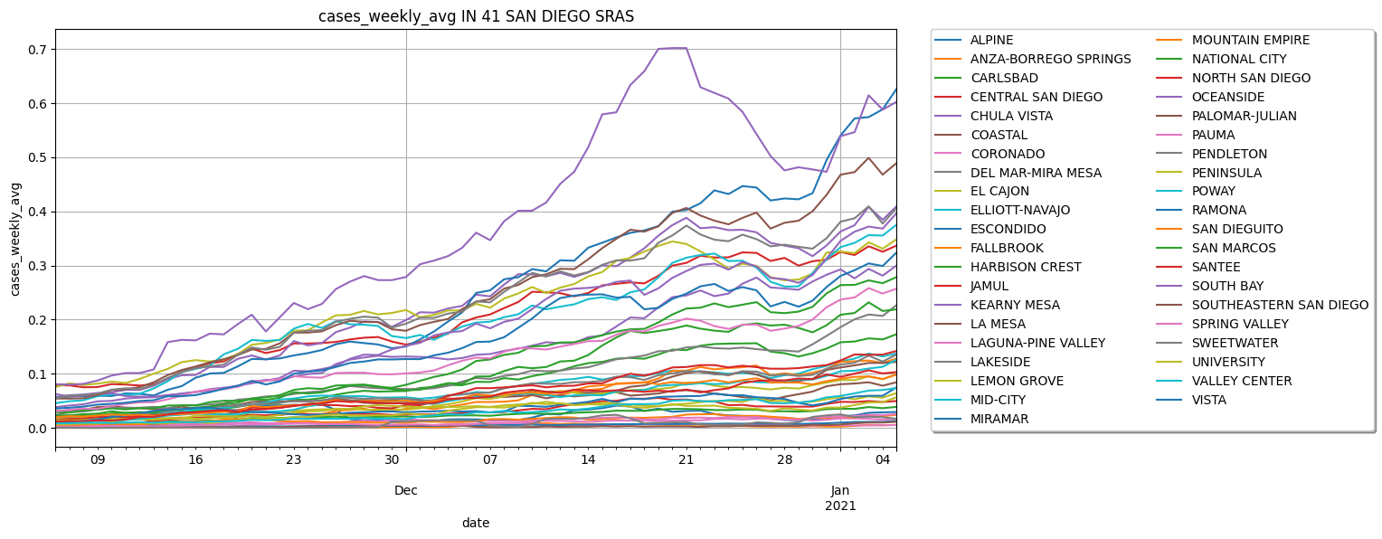
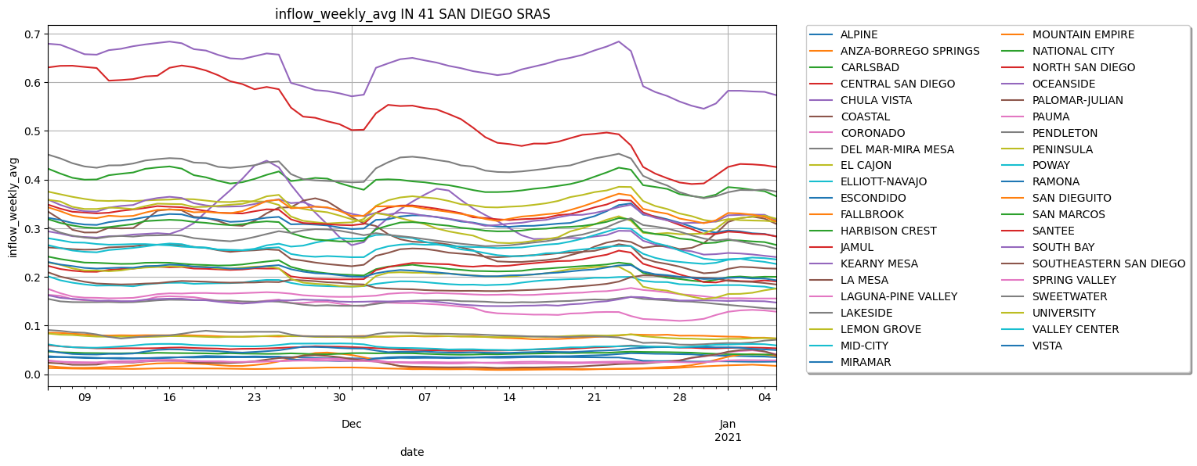
Methods
4. Time division
4.1. Phase approach
5 phases/ 6 phases

Slide 34
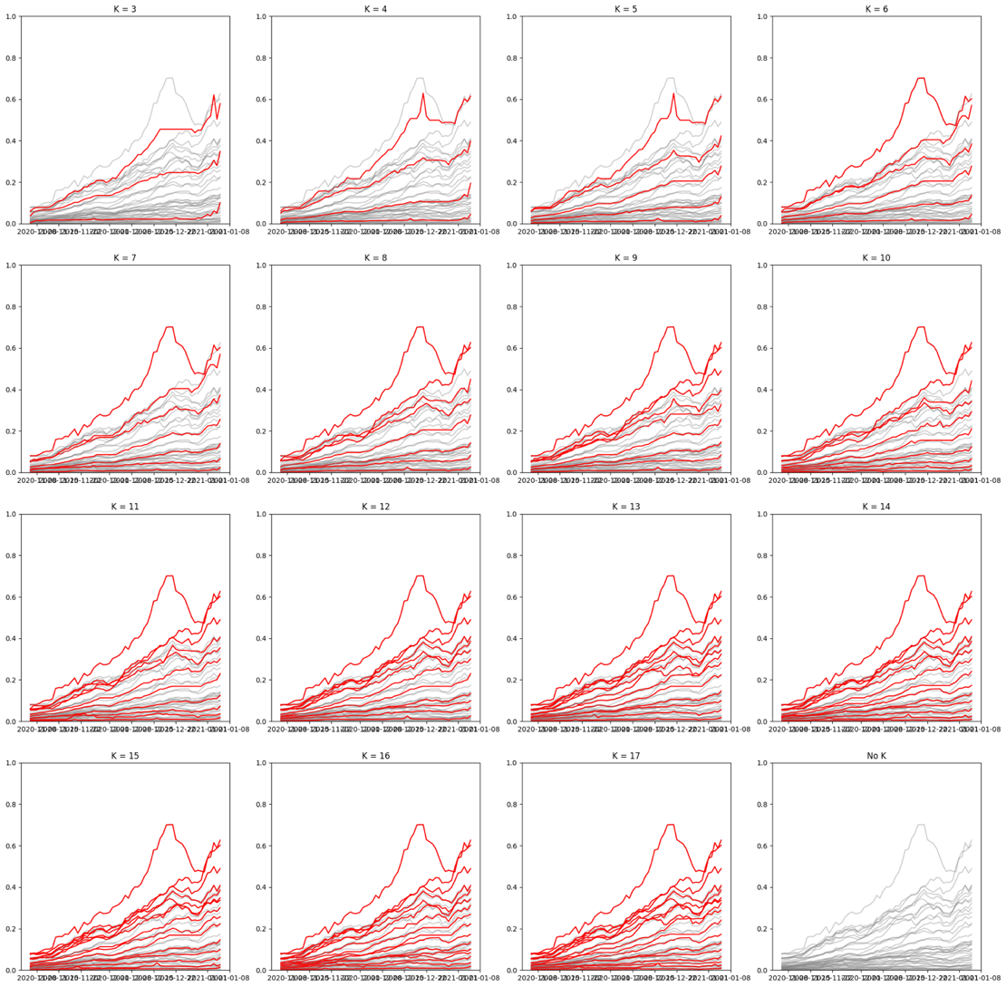
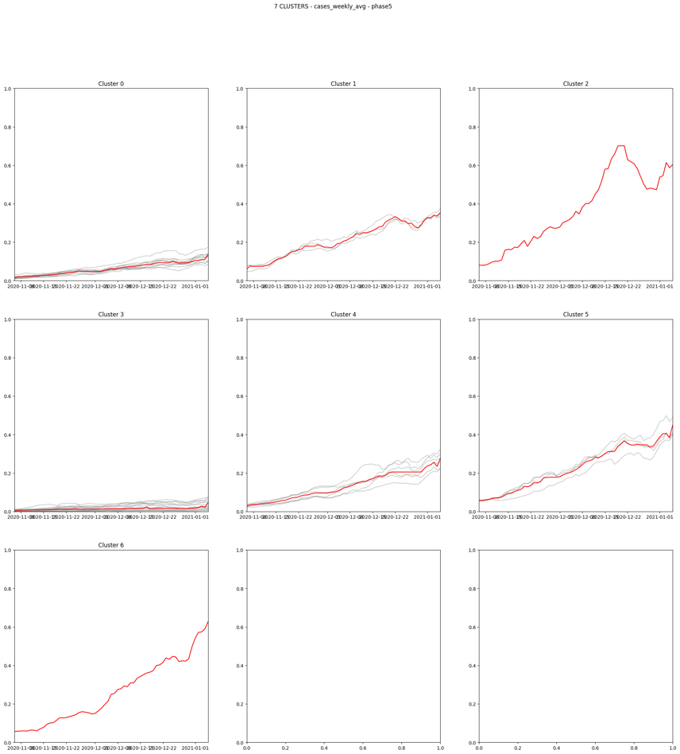
Methods
Phase approach
TS K-Mean Clustering

Slide 35
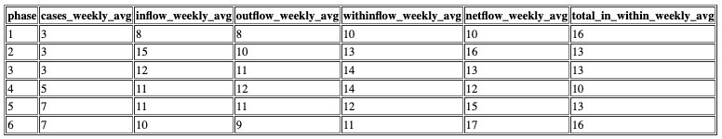
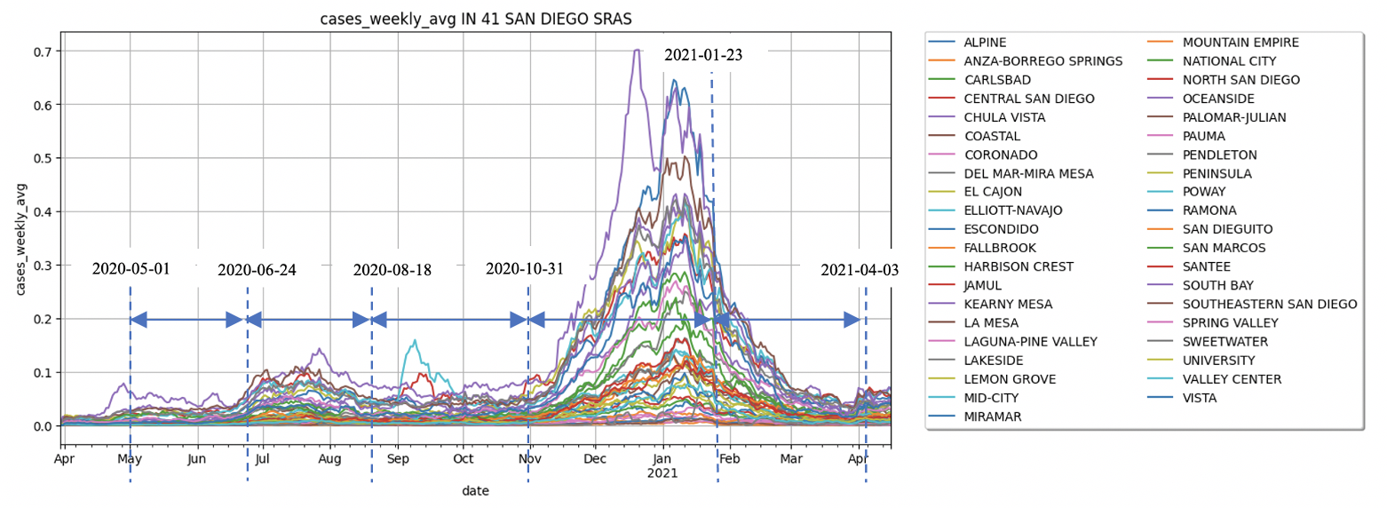
Methods
Phase approach limits
Randomized initialization
Best k selection
Time division

Slide 36
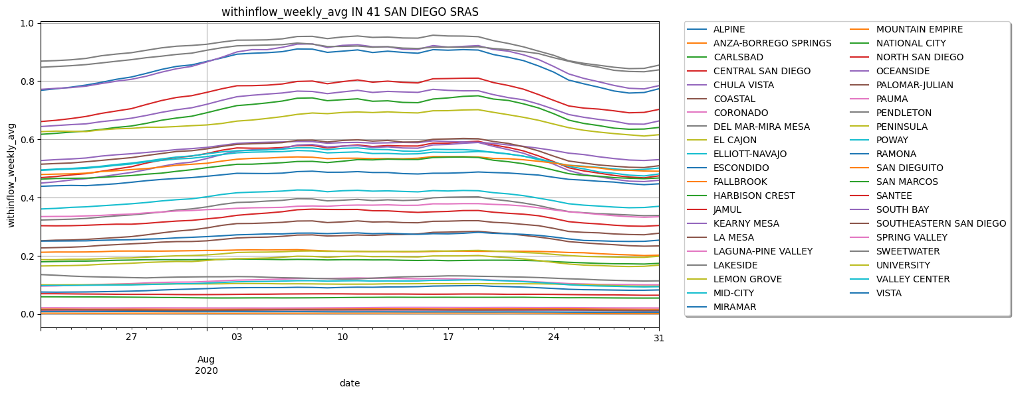
Methods
Phase approach limits
Randomized initialization
Best k selection
Time division

Slide 37
Methods
4. Time division
4.2. 14-day approach
previous 14 day + target day
7 – day lag
Filter DTW < 1.0, slopes > 0

Slide 38

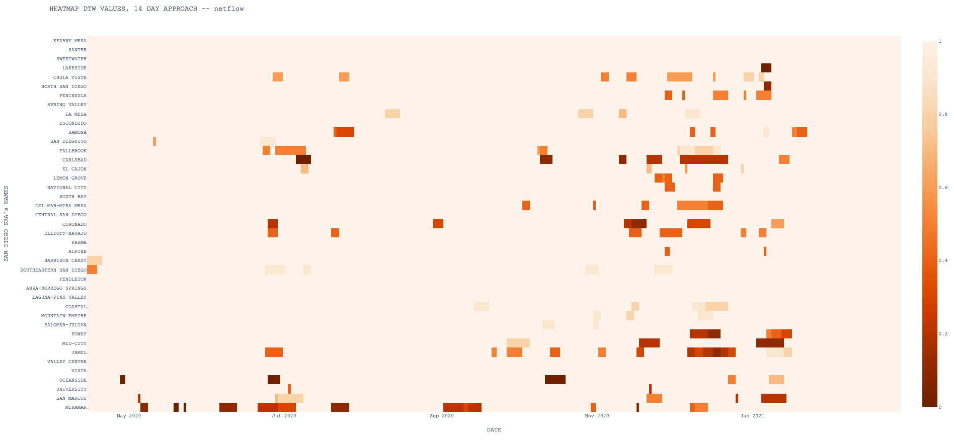
RESULTS
When did it happen?
Netflow

Slide 39
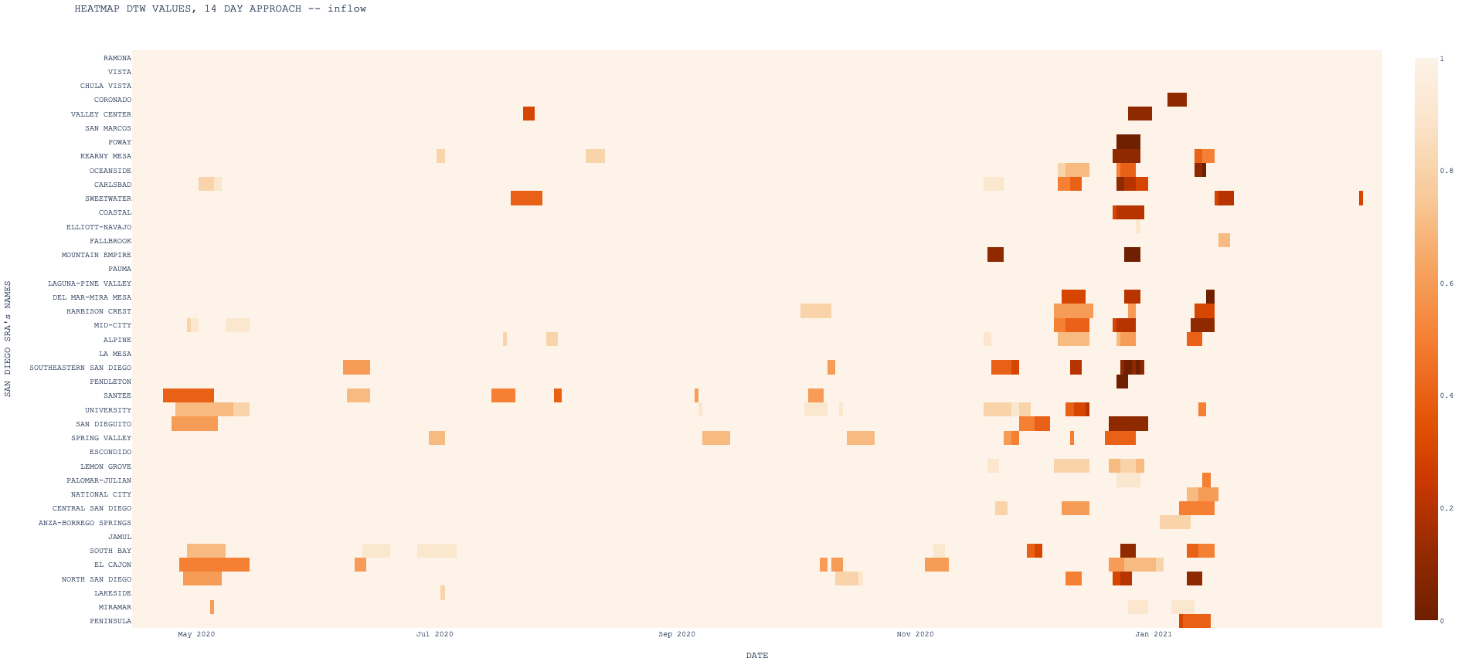
RESULTS
When did it happen?
Inflow

Slide 40
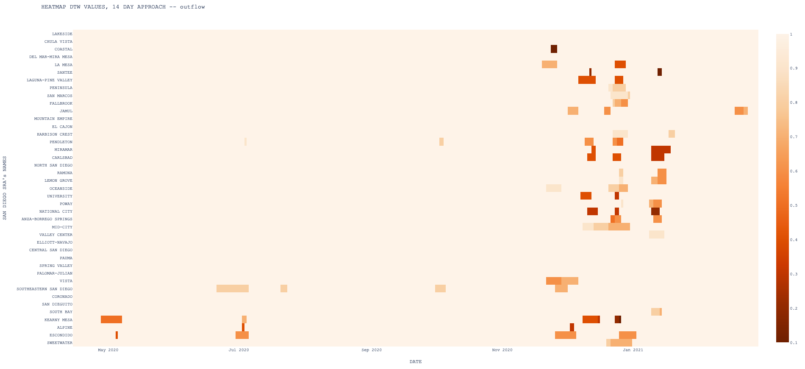
RESULTS
When did it happen?
Outflow

Slide 41
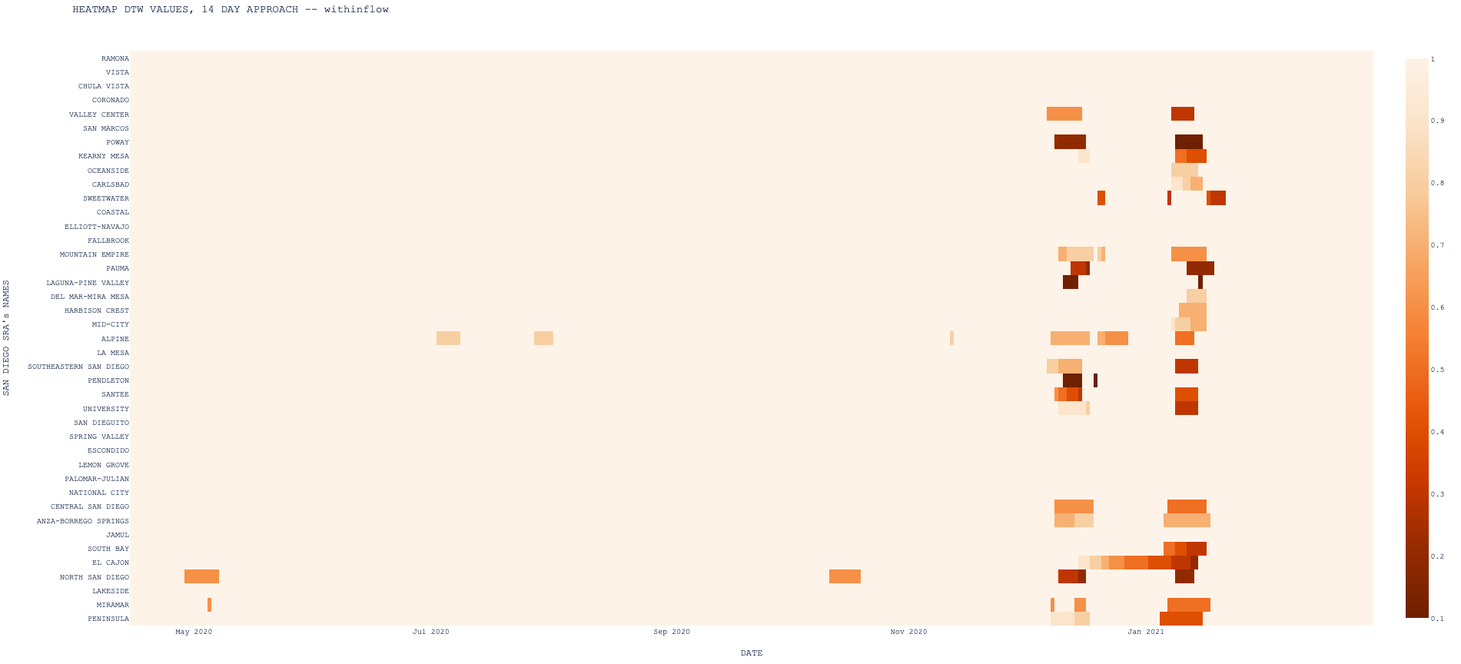
RESULTS
When did it happen?
Withinflow

Slide 42
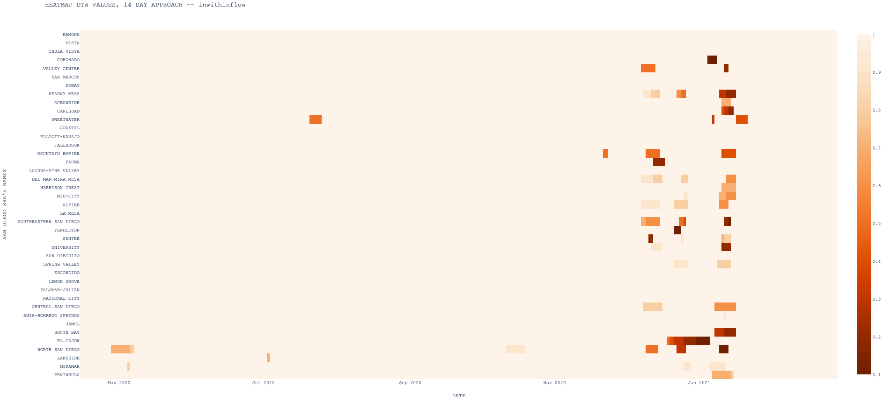
RESULTS
When did it happen?
Inwithinflow

Slide 43
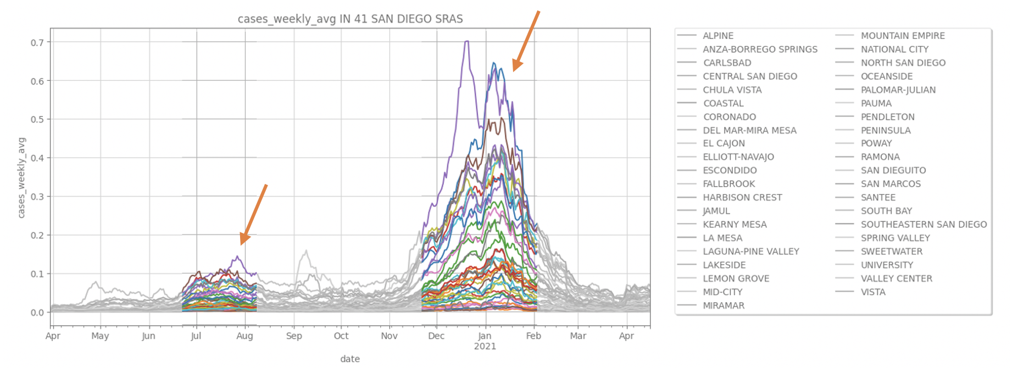
RESULTS
When did it happen? Validate
COVID-19 case number

Slide 44
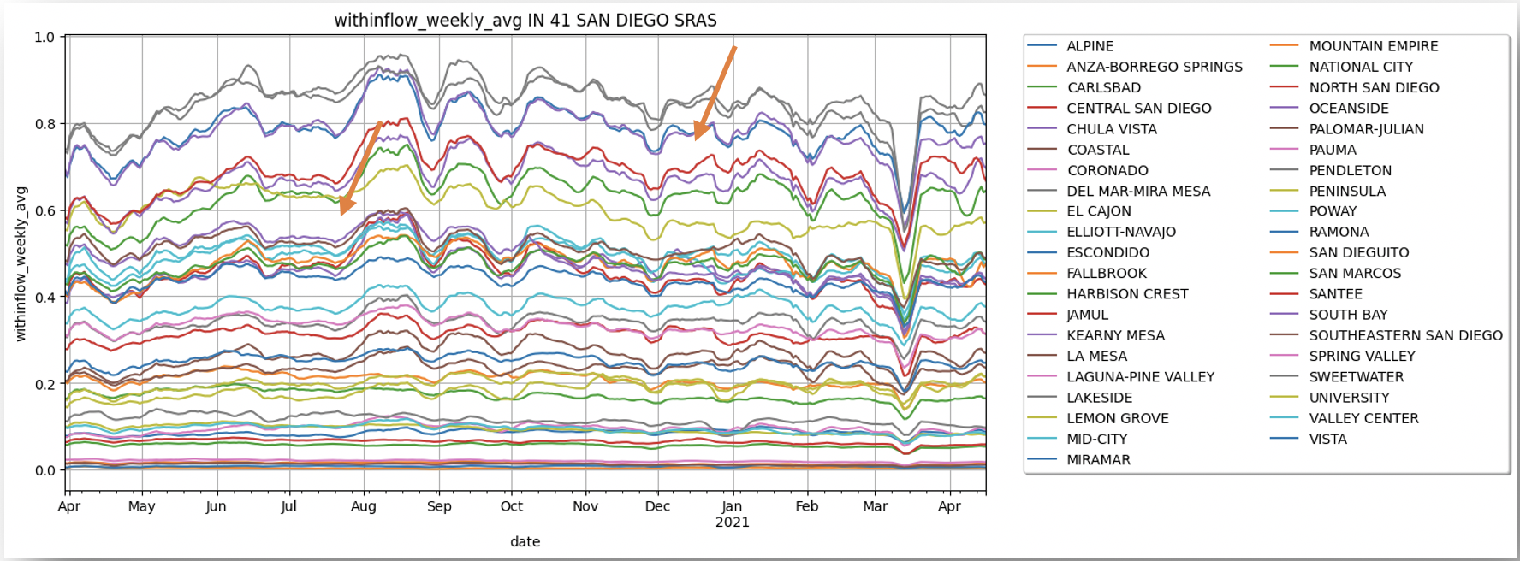
RESULTS
When did it happen? Validate
Withinflow

Slide 45
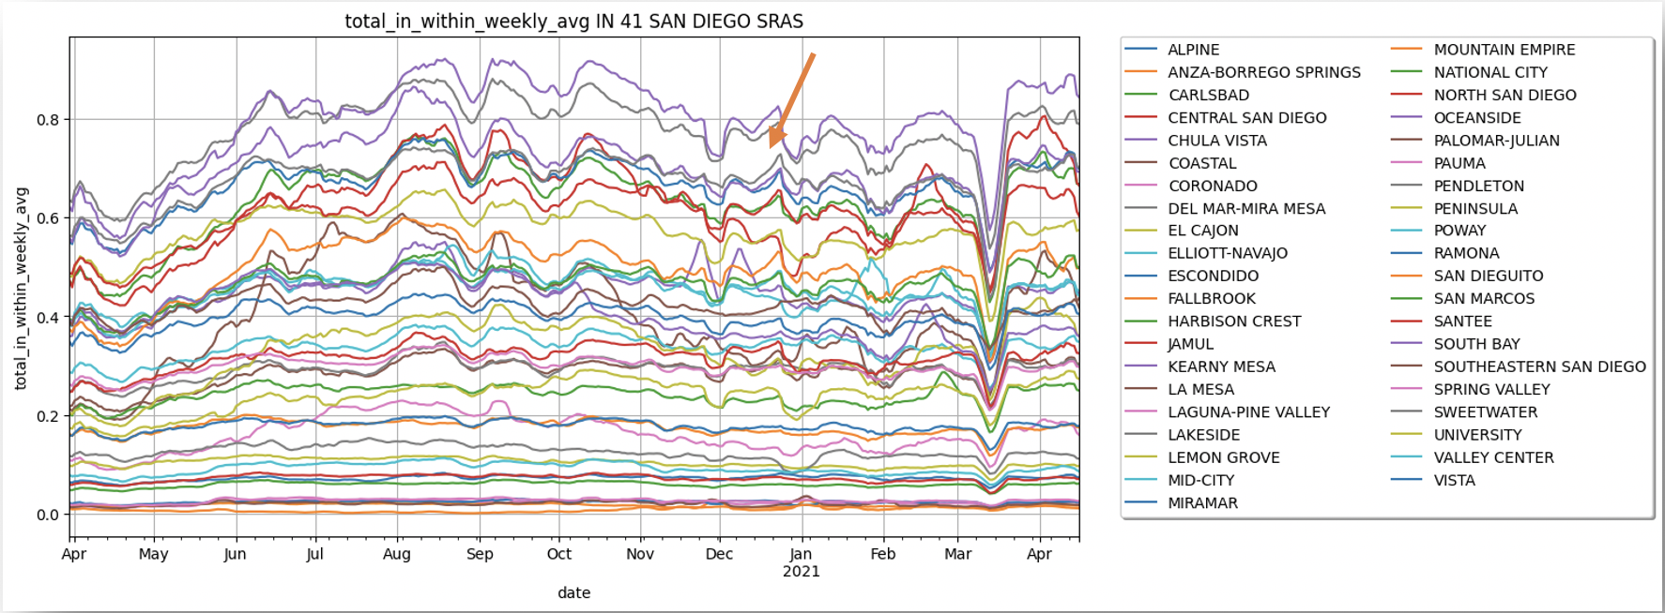
RESULTS
When did it happen? Validate
Total in-within-flow

Slide 46
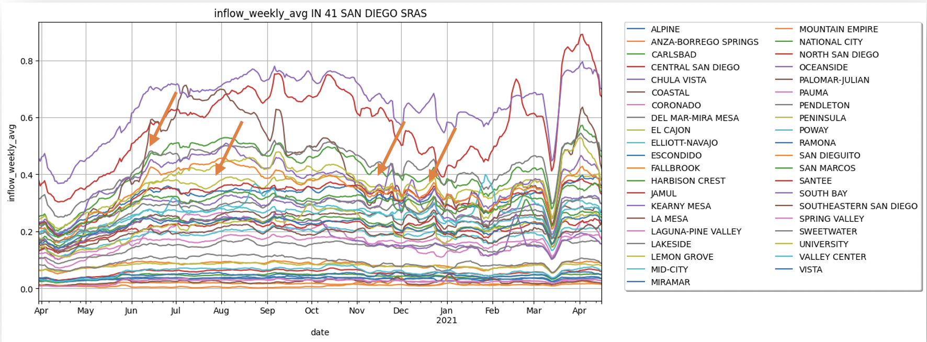
RESULTS
When did it happen? Validate
Inflow

Slide 47
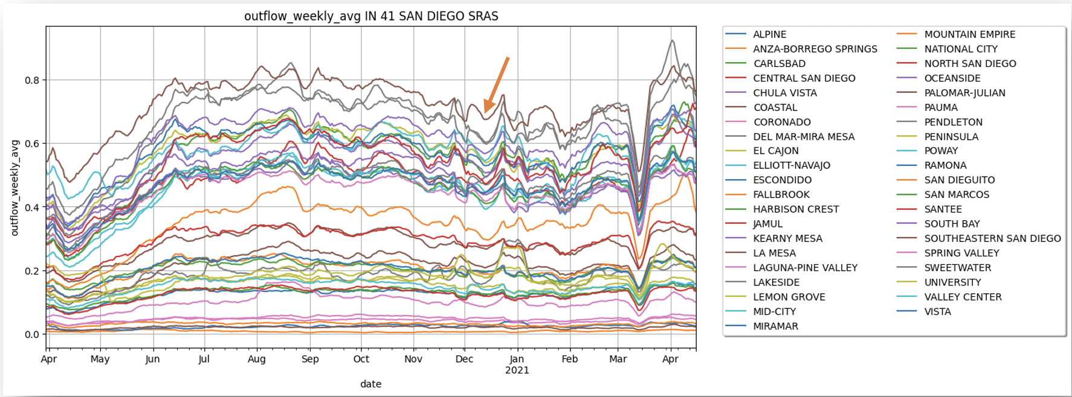
RESULTS
When did it happen? Validate
Outflow

Slide 48
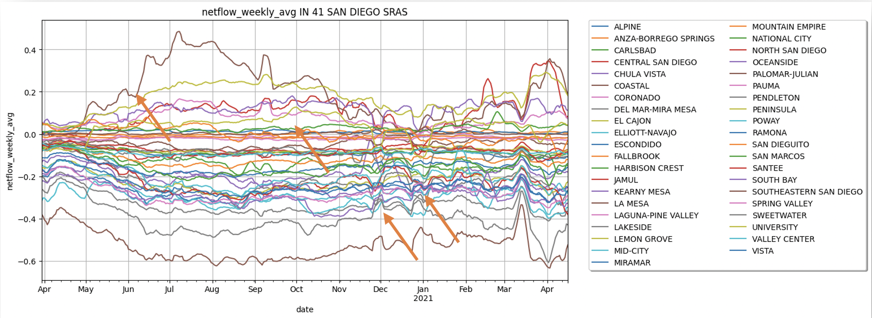
RESULTS
When did it happen? Validate
Netflow

Slide 49
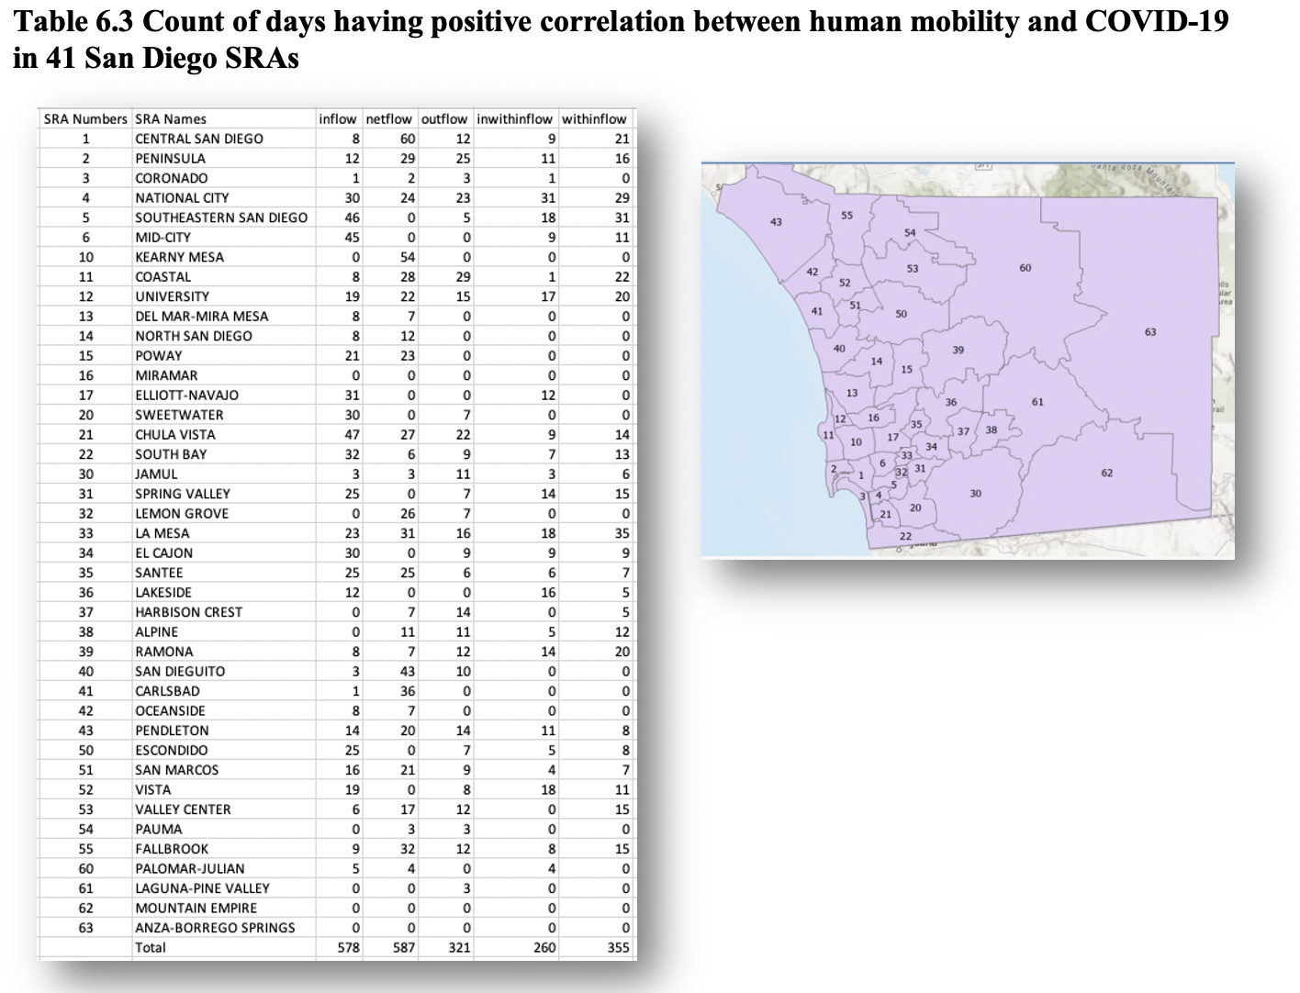
RESULTS
2. Where did it happen?
Count the days
DTW < 1.0
Slopes > 0
Choropleth maps
SRA names
Spillover effects

Slide 50
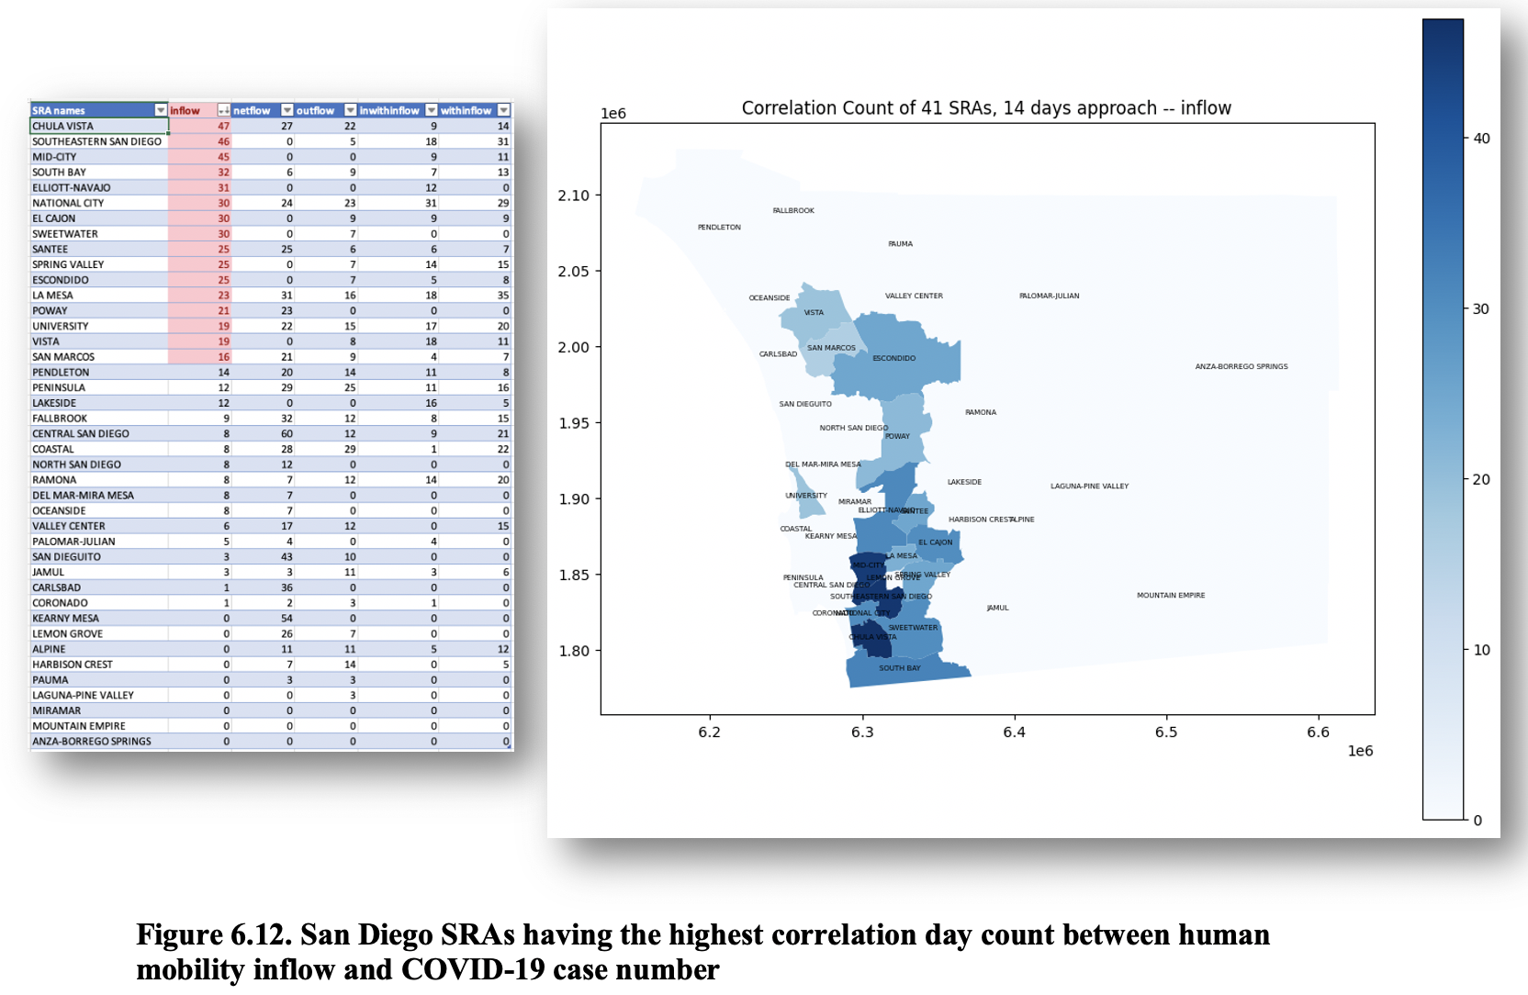
RESULTS
2. Where did it happen?
Inflow

Slide 51
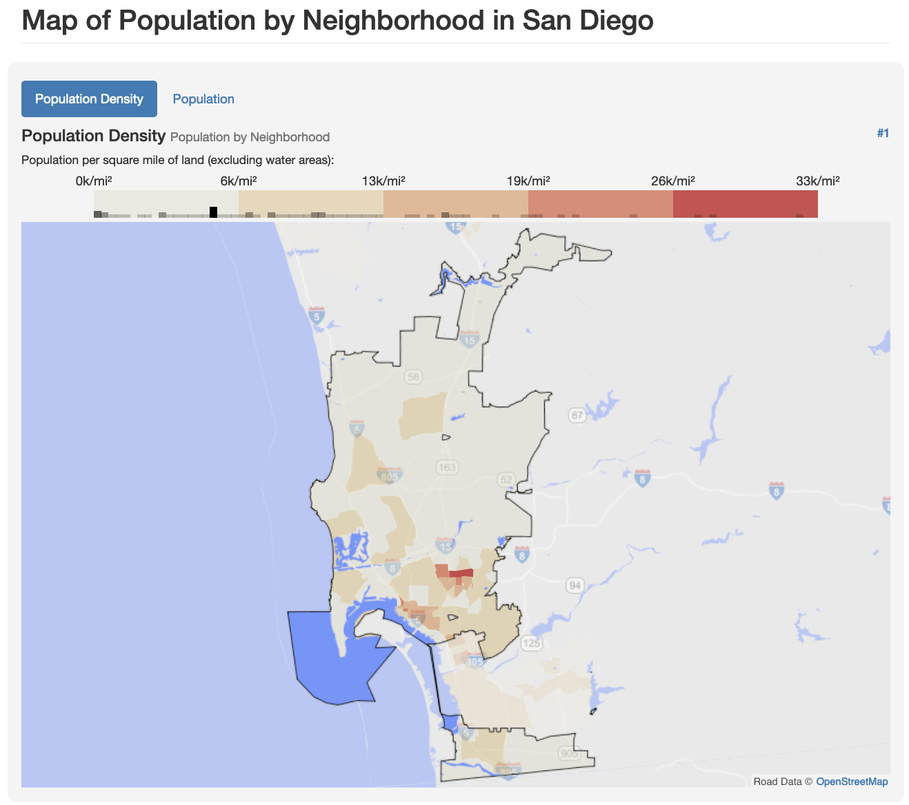
RESULTS
2. Where did it happen?
Inflow
https://statisticalatlas.com/place/California/San-Diego/Population

Slide 52
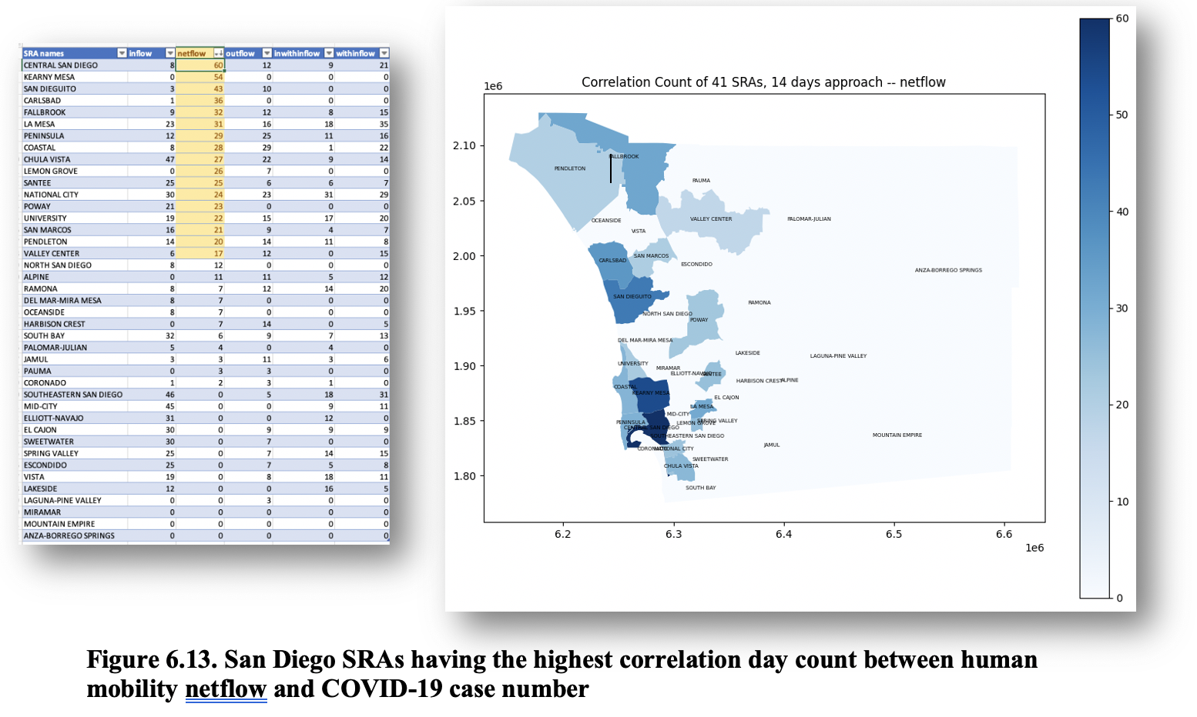
RESULTS
2. Where did it happen?
Netflow

Slide 53
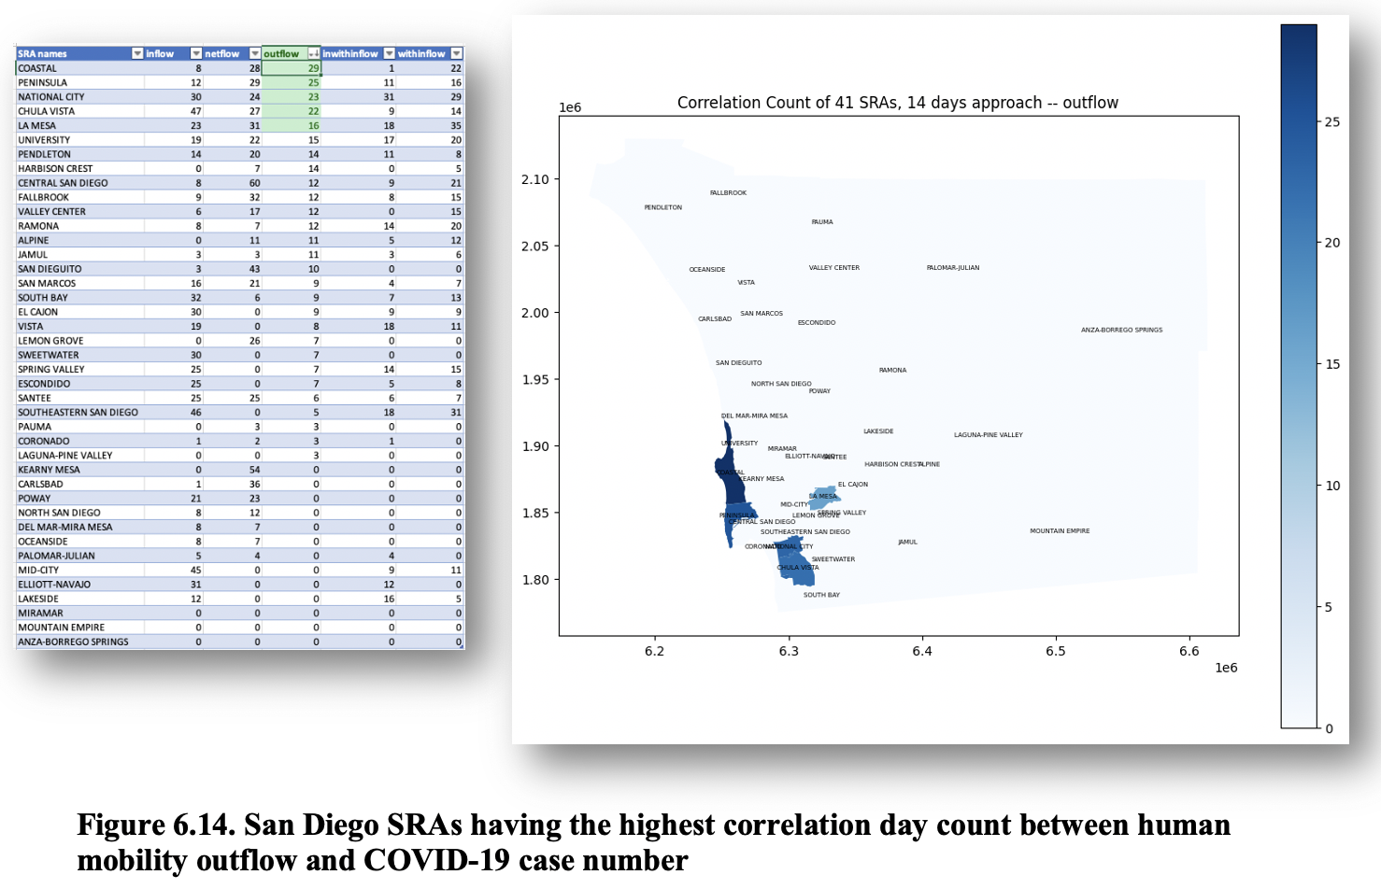
RESULTS
2. Where did it happen?
Outflow

Slide 54
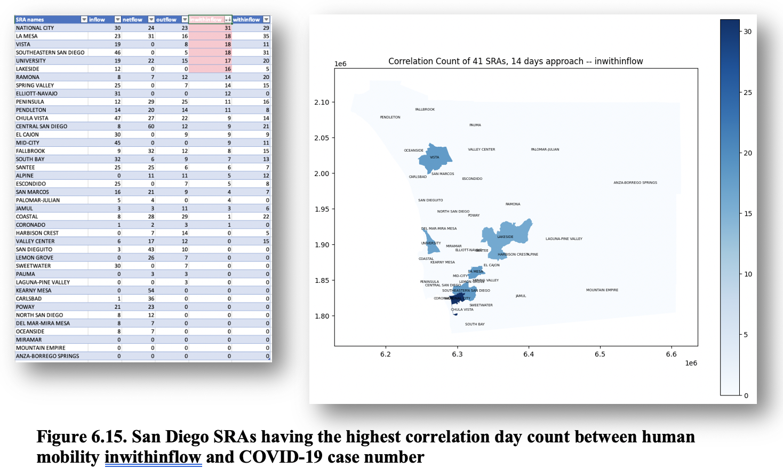
RESULTS
2. Where did it happen?
Inwithinflow

Slide 55
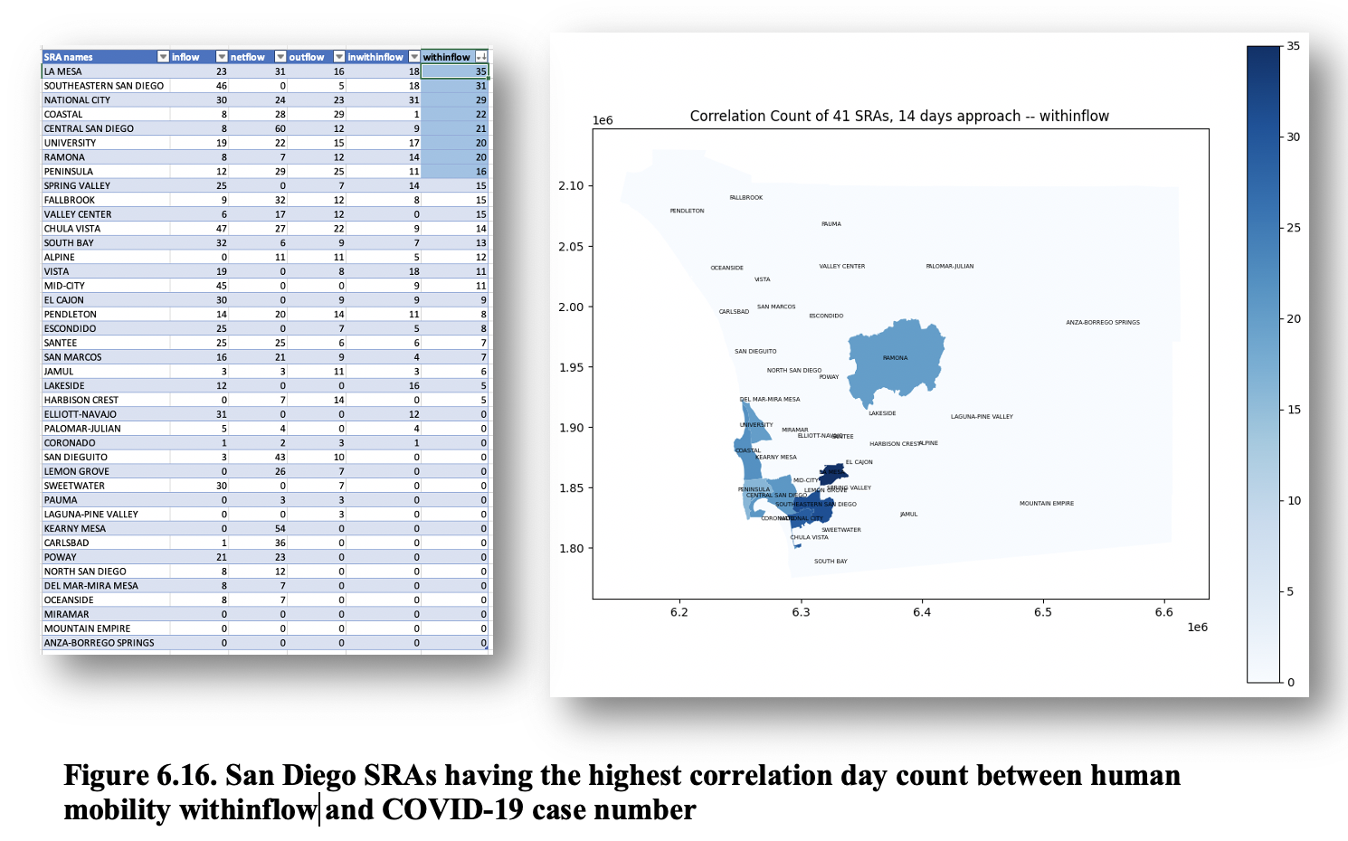
RESULTS
2. Where did it happen?
Withinflow

Slide 56
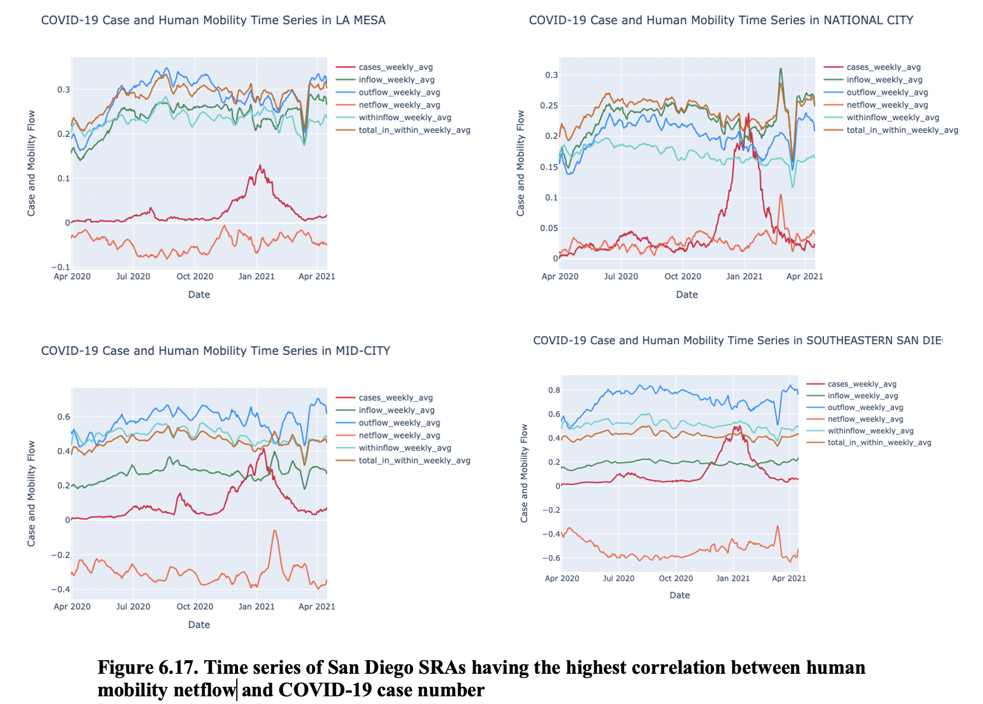
RESULTS
2. Where did it happen?
Validate

Slide 57
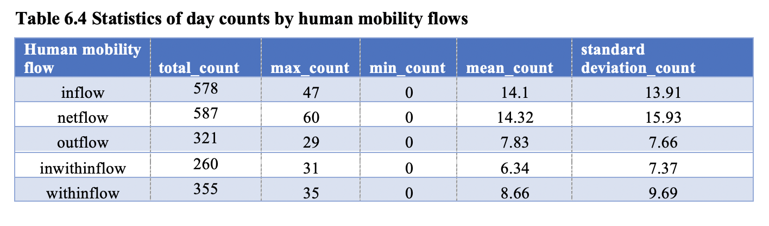
RESULTS
3. What mobility flow has impact?
Inflow and netflow have most impact
Outflow, withinflow, inwithinflow have less impact

Slide 58
Discussion
More in line with the conclusion that the relationship is diverse
Association depends on time and place
Nouvellet et al., 2021, Elarde et al., 2021, Li et al., 2021, Praharaj & Han, 2021, Wang et al., 2020, and Yuan et al., 2020
Association exists in May and June, especially inflow and netflow. Outflow, withinflow and inwithin flow do not show that much association.
Mostly in the winter and holiday 2020 and early 2021, consistent in all five types of human mobility

Slide 59
Discussion
Limitation
Decrease-decrease and stable-stable relationship
Shifting human mobility time series 7 days backward
Decimal place parameter for slope values
Extend to other factors: vaccination, hand washing, wearing mask, social distancing
COVID-19 data in March 2020

Slide 60
conclusion
The relationship between human mobility and COVID-19 in San Diego depends on time and place.
The 14-day approach is more efficient than the phase approach and Time Series K-Mean Clustering in this study.
The positive correlation happened in May and June 2020 for inflow and netflow, but the most during the winter/holiday 2020.
The people flow coming to San Diego County (inflow and netflow) have more impact on the Covid-19 case increase in San Diego than the flows of people going out of the County.
Spatial association among SRAs does exist, depending on specific time and place.

Slide 61
conclusion
The South region -- South Bay, Chula Vista, National City, Sweetwater – and the Central region – including Mid-City and Southeastern San Diego are affected the most by the human mobility inflow.
The North Central -- Coastal, University, Kearny Mesa, Peninsula -- is affected the most by the mobility netflow.
The withinflow has the biggest impact on Peninsula, Coastal, University, Coronado, Central San Diego, and Southeastern San Diego
La Mesa and National City had the COVID-19 case number increase affected by at least one human mobility type (inflow, outflow, netflow, withinflow, inwithin flow).

Slide 62
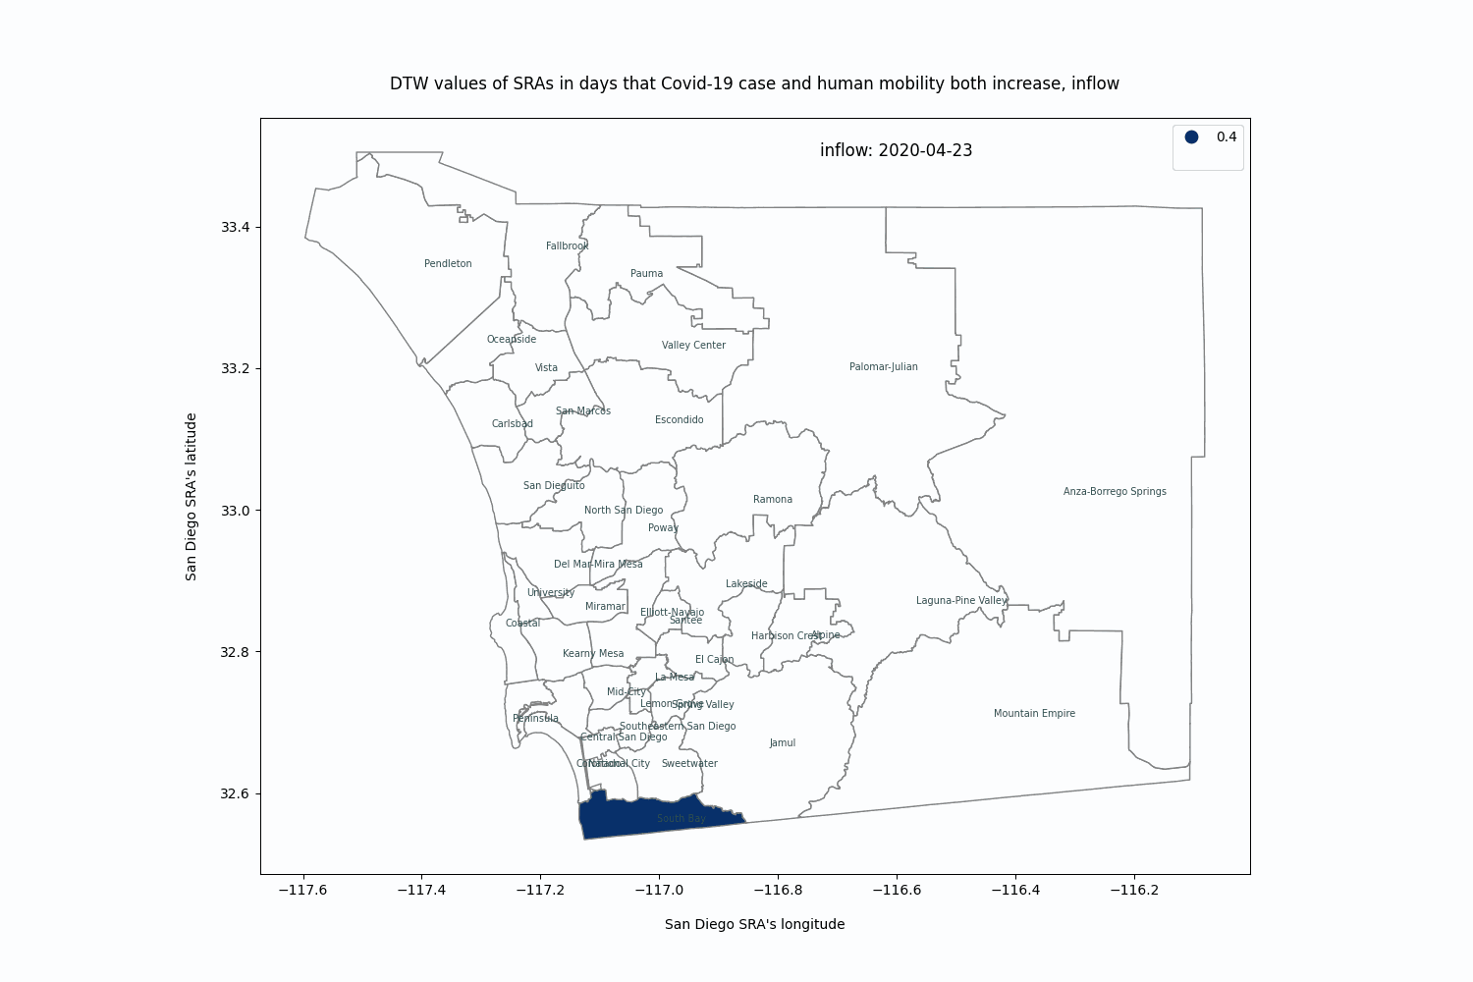

conclusion
Inflow
Netflow

Slide 63
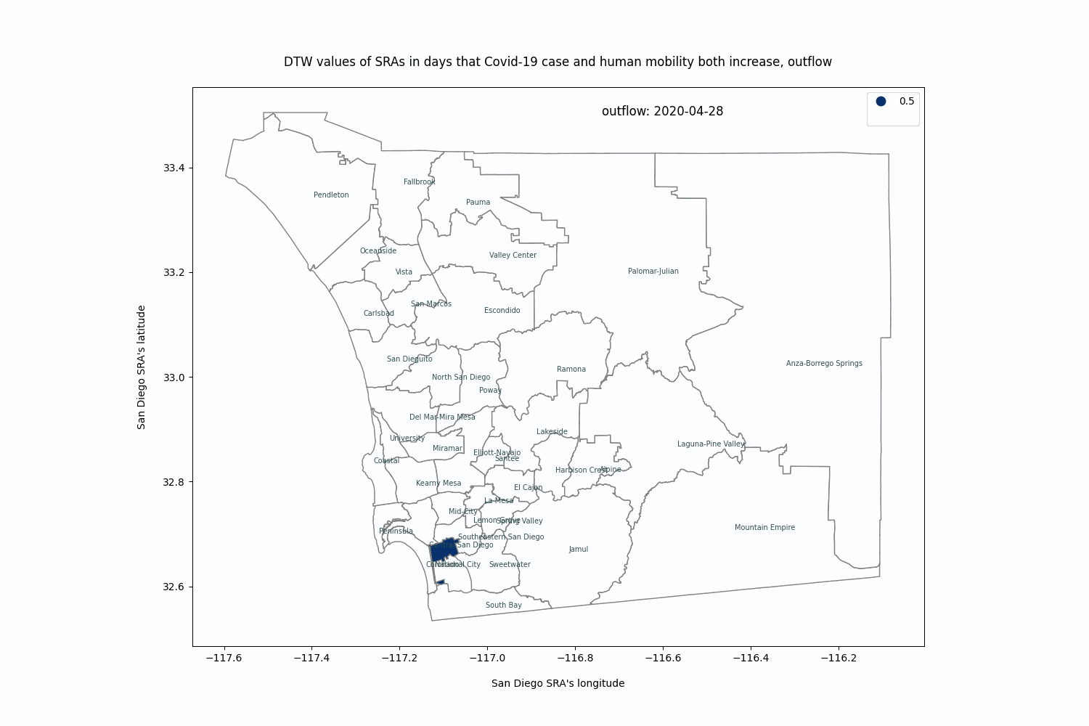


Outflow
Withinflow
Inwithinflow

Slide 64
acknowledgement
My Advisor: Dr. Atsushi Nara
My Committee Members:
Dr. Atsushi Nara (Chair), Department of Geography
Dr. Ming-Hsiang Tsou, Department of Geography
Dr. Eyal Oren, School of Public Health
HDMA, SafeGraph
SDSU Big Data Analytics (BDA) MS Program

